Slide 1
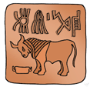
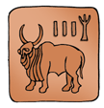
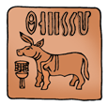
Ancient India

Slide 2
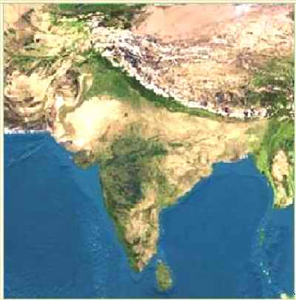
India’s Geography
India is a land of great Diversity
Has over 110 different languages with over 1100 dialects spoken
Geography ranges from fertile forests to desert, to high mountains
Indian Subcontinent
Subcontinent of Asia
Divided from Asia by Himalaya and Hindu Kush mountain ranges

Slide 3
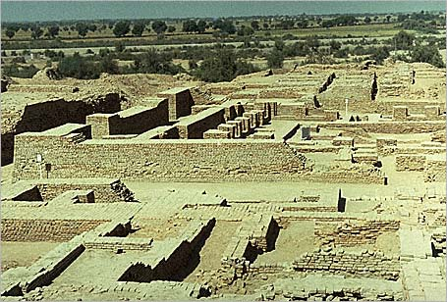
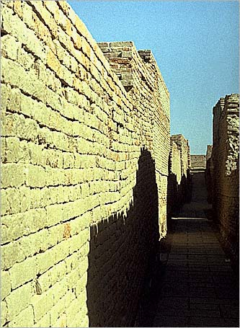
Mohenjo-Daro
Organization: These cities were very carefully planned.
Harappa and Mohenjo-Daro
Population: It is thought that Harappa had up to 35,000 people at its height and that Mohenjo-Daro has between 35,000-40,000 people.

Slide 4
Aryan Invasion/Migration
Aryans come to India
1500 BCE – group of Indo-European nomads
Warfare = were advanced fighters
Eventually spread throughout India

Slide 5
Aryan (Vedic Era)
1500-400 BCE
Government
ruler not above the law, small chiefdoms, could be replaced.
Rajas – Princes of the Aryans, warring chieftains who fought each other, seizing territory and prisoners
Major Accomplishments or Characteristics
creation and use of Sanskrit
Vedas written
pastoral life for most people
creation of caste system

Slide 6
Aryan (Vedic Age)
Influence of Iron: Iron tools allowed for improvements in Agriculture, including the plow
Agriculture
Tools and irrigation = clear jungle around the Ganges
Basic crops – grains = north, rice = south; cotton and spices

Slide 7
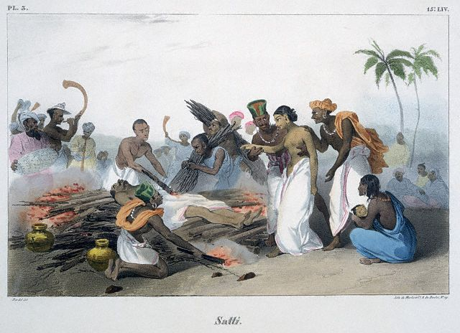
Aryan (Vedic Age)
Family Life: Dominated most social activity
Extended family
Patriarchal = male dominated; men inherit property and boys educated
Arranged marriages (parents do this for their young children)
usually for political and economic reasons
Status of women
Very low social status
Suttee (Sati) – women expected to thrown themselves on the crematory fires of their dead husbands; refusal = disgrace

Slide 8
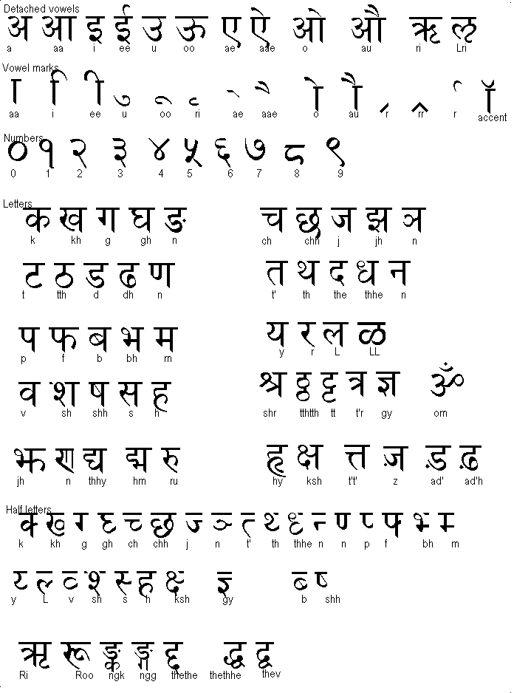
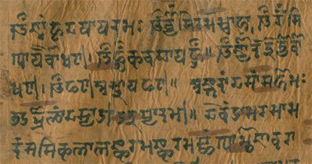
Sanskrit Writing
The written language enabled the peoples to write down their stories and religious chants and rituals
Eventually became the sacred texts of Hinduism, the Vedas

Slide 9
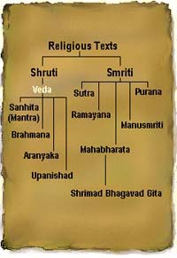
The Vedas
1200 BCE-600 BCE
Written in Sanskrit
Hindu core of beliefs
Hymns & poems
Religious prayers
Magical spells
Lists of the gods
Rig Veda = oldest work

Slide 10
Varna – Social Level
Brahmins
Kshatriyas
Vaishyas
Shudras
Pariahs [Harijan] → Untouchables

Slide 11
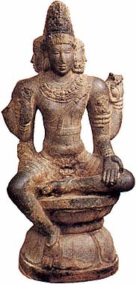
Caste System
Who is…
The mouth?
The arms?
The legs?
The feet?
Brahmins
Kshatriyas
Vaishyas
Shudras

Slide 12
Caste System
System of social division in India
Originally just four castes
Priests = Brahmins
Warriors and princes = Kshatryias
Merchants, large landowners, and artisans = Vaishya
Small farmers/manual laborers = Shudra
Each caste has it’s own Dharma, or duty. You must obey the dharma of your caste to earn good Karma and be able to be reincarnated at a higher caste in the next life

Slide 13
Caste System
System was not originally particularly rigid
Contained opportunity for mobility
Intermarriage between castes was allowed
System became increasingly complex and rigid as time went on
Hundreds of castes
No social contact between them
At bottom, were the “untouchables”

Slide 14
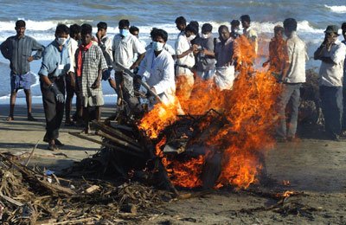
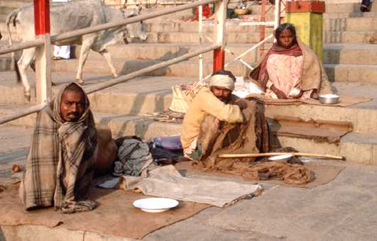
Untouchables
About 5% of the population of India. They are required to perform the dirtiest jobs dealing with trash, human waste, and death.
So low that they are not a part of the caste system
They were required to carry of noisemaker to warn people of the approach so they would not accidentally run into someone.
Discrimination against them continues today, even though the caste system has been declared illegal.

Slide 15
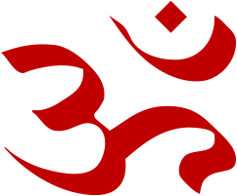
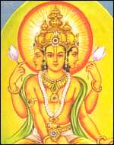
Hinduism
Aum, or Om
Seen as the sound of the universe
Originally polytheistic
Over time, three of the most important gods merged together to create a three-part monotheistic deity called Brahman
Brahma (creator)
Vishnu (protector)
Shiva (destroyer)
Multiple Gods
Hindus believe that Brahman is too complex for people to understand and so it is divided into the many different gods and goddesses of Hinduism to simplify it.
Often seen as polytheistic, but some argue that it is not because all of the gods are part of the one universal god.

Slide 16
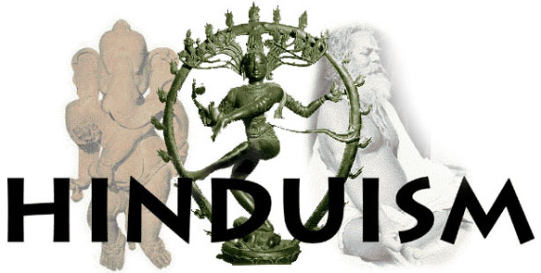
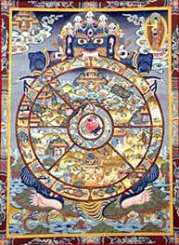
Hinduism
Every living thing is related
All living things have souls
Atman: The Essential self or the Soul; essence of Brahman that is inside every living thing
Reincarnation
Each soul is reborn in the body of some other creature over and over again

Slide 17
Moksha: The ultimate goal of Hinduism. To achieve Shanti, or ultimate peace. To be released from the cycle of death and rebirth.
Karma
All of the actions in this life that affect your next life.
Has nothing to do with revenge or retribution
Moksha
Union with Brahman.
Release from Samsara
Dharma
Your Duty. The rules you must follow to earn good Karma.
Samsara
Being stuck in the cycle of death and rebirth.
Suffering

Slide 18
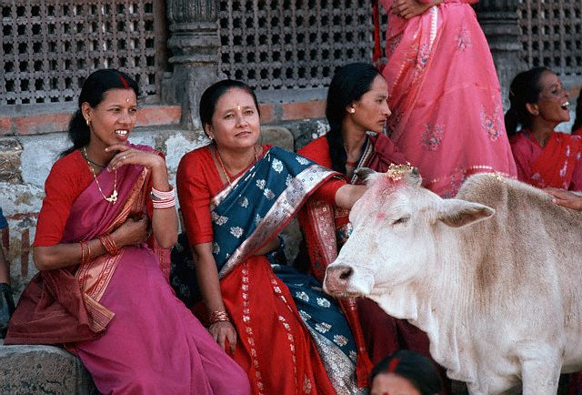
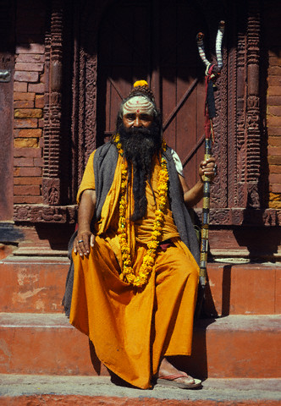
Hindus consider all life to be sacred and so they practice the principle of ahinsa, or non-violence.
Because of this many Hindus are vegetarian
Cows are Sacred in India because they are seen as the most generous of all animals.
The sacred texts of Hinduism are the
Vedas and Upanishads
.

Slide 19
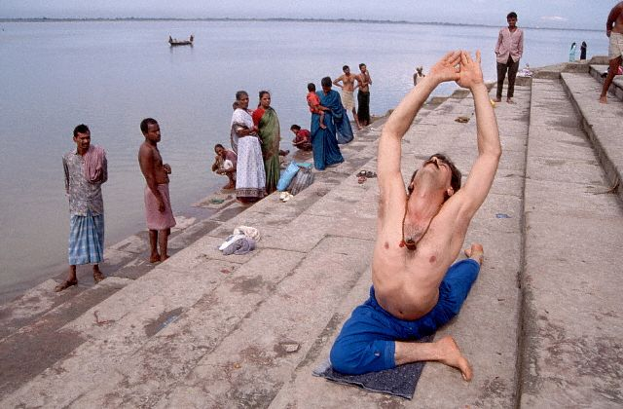
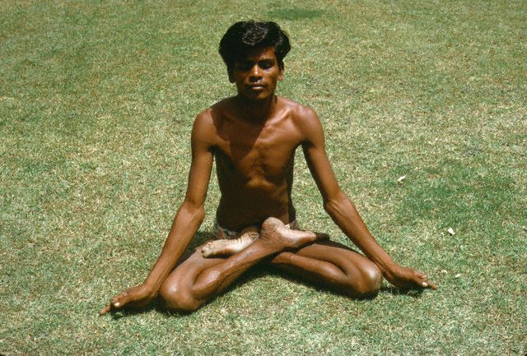
Yoga
Was developed as a method of training the body to achieve oneness with Brahman.
It is a form of meditation
Mastery over body, mind, and emotions

Slide 20
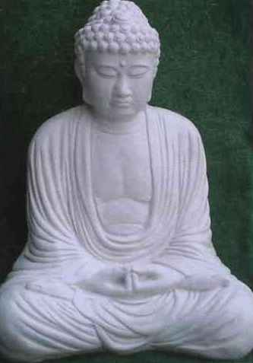
Gautama the Buddha
Gurus appear around 600 BCE who argued that Hinduism had become too materialistic and that people should be more spiritual
Foremost guru was Gautama the Buddha
Means “Enlightened One”
Search for permanent escape from wheel of suffering
Argued that desire for material goods causes suffering

Slide 21
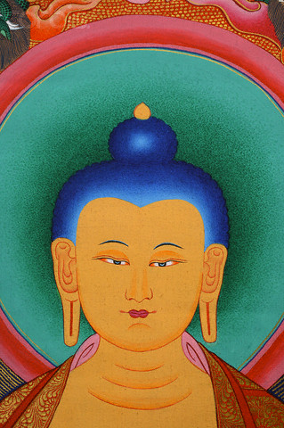
Siddhartha Gautama: Prince turned Buddha
Birth: was born into the wealthy warrior caste. It is believed that before his birth his mother had a dream of an elephant piercing her side with its tusk. This was interpreted to mean that he would be a great leader or a wandering holy man.
Childhood: his mother died shortly after his birth. His father lavished him with wealth so he would never want to leave the palace. He was completely sheltered from the outside world.

Slide 22
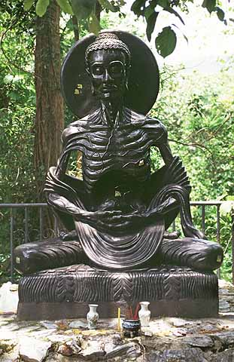
Siddhartha Gautama
The Three Visions
Siddhartha grew up never knowing much about the outside world.
He married young and had a son.
When he was in his 20’s he went outside the palace and experienced three visions which changed his life.
The saw someone in advanced old age.
He saw a very sick person
He saw a dead body.
Siddhartha had never before been aware of human suffering.
He felt his life was a lie and abandoned it to become an ascetic, or wandering holy man in an attempt to find a way to end human suffering.

Slide 23
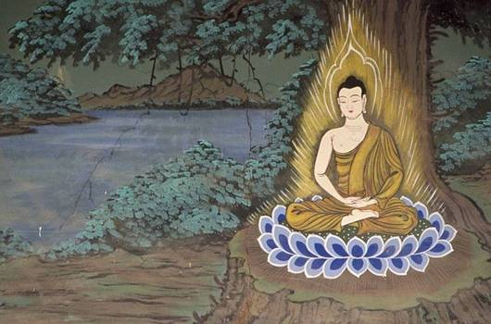
Siddhartha Gautama
Seeking Truth
Siddhartha tried many different ways of achieving enlightenment.
He tried mediation, fasting, physical discomfort, but none along worked for him.
He almost starved himself to death at one point.
After that he knew he needed to try something different.
Enlightenment
Siddhartha decided that he would meditate until he discovered the way to end human suffering.
Bodhi Tree: He sat under a Bodhi tree and he mediated for 40 days amidst temptation, and at the end said that he was “awake” he had achieved, Nirvana, or Enlightenment. This is when he became the Buddha, or enlightened one.

Slide 24
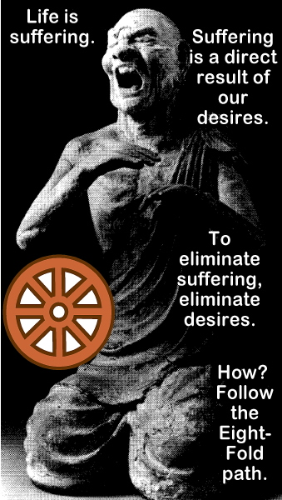
Teachings of the Buddha
The Buddha gave his first sermon in the deer park where he taught the four main ideas of his teachings
Four Noble Truths
All life is full of suffering
We suffer because we desire things that are illusions. We want material possessions
The way to not suffer is to overcome our desires
To do that, one must follow the Eightfold path, or Middle Way

Slide 25
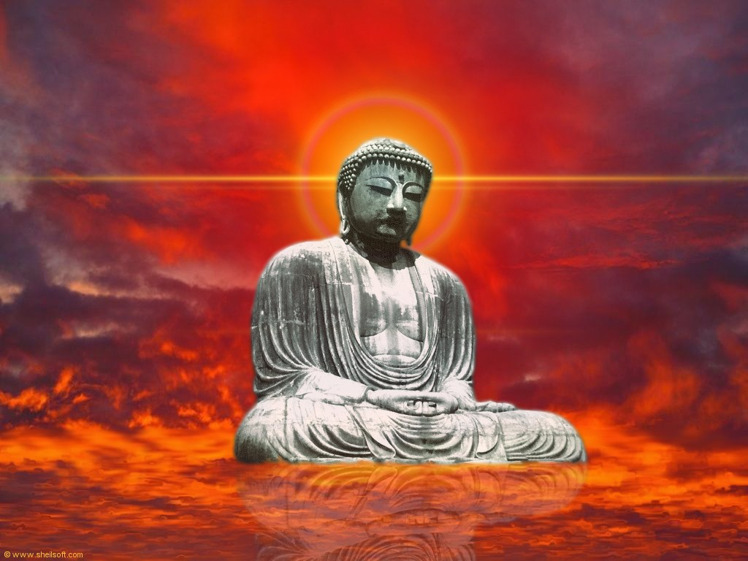
Achievement of Nirvana
8-step process to escape wheel of suffering
Included non-violence, rejection of selfish desires, cultivating compassion and honesty, cleansing mind of evil thoughts, etc.
Nirvana—permanent escape from wheel of suffering
Attainment of permanent peace and tranquility

Slide 26
The Eightfold Path (Middle Way)
1. Right view - One must understand the four noble truths.
2. Right intention - Know what you really want
3. Right speech - Speak truth and speak well of others.
4. Right action - Do not kill, steal, lie, be unchaste, or take drugs or alcohol.
5. Right livelihood - Don’t do a job that harms others.
6. Right effort - Do your best, always
7. Right mindfulness - Keep control of yourself and your urges.
8. Right concentration - One must meditate to understand the world.

Slide 27
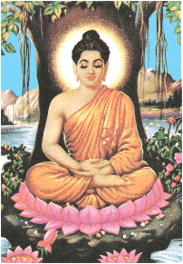
Buddha’s Life
Buddha practices what he preached
Only owned simple robe, walking stick, and wooden bowl
Always slept outside and walked everywhere he went
Presented his creed in a simple language
Treated all persons equally
Many people attracted to him as a result
Millions of converts across Asia

Slide 28
Teachings
Caste System: The Buddha rejected the caste system. He said all people were capable of achieving enlightenment in one lifetime. Although not everyone did, so Buddhism does believe in reincarnation.
Ahinsa: Taught non-violence, same as Hinduism
Meditation: Taught that one should meditate. Yoga and Martial arts are seen as a form of mediation.
Reincarnation: The Buddha taught the belief of Samsara, or Reincarnation. As long as one is tied to material possessions of this earth and does not achieve enlightenment then one will have suffering.
Nirvana: The ultimate goal of Buddhism, to be released from the cycle of death and rebirth.

Slide 29
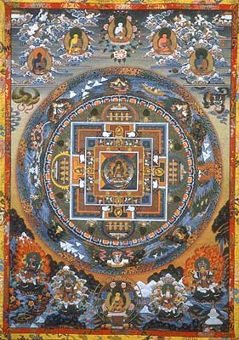
Spread of Buddhism
Convents and Monasteries: The Buddha had many followers, both men and women. He did not discriminate based on gender.
Death of the Buddha: He died of food poisoning at the home of a friend.
Scriptures: His teachings were collected in the Tripitika, or three baskets of wisdom.

Slide 30
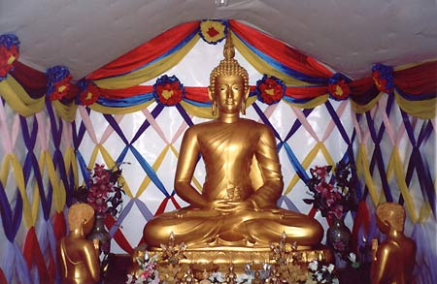
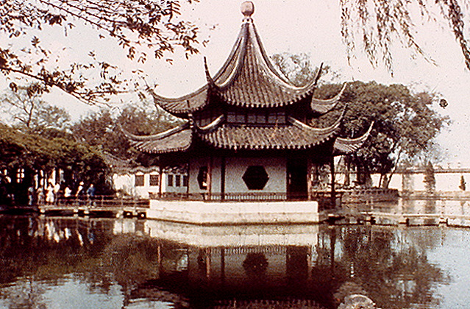
Buddhist Traditions
Buddhism ultimately split into 2 traditions
Theravada (Little Vehicle)
Do not view Buddha as a god, was just a great man
Strict practice and dediction
Mahayana (Big Vehicle)
Largest of the two
Buddha was human incarnation of Brahma; Buddha was a god
Led to worship of Buddha, creation of idols, elaborate rituals, and temples
Vow not to reach Nirvana, instead stay to help others reach Nirvana first

Slide 31
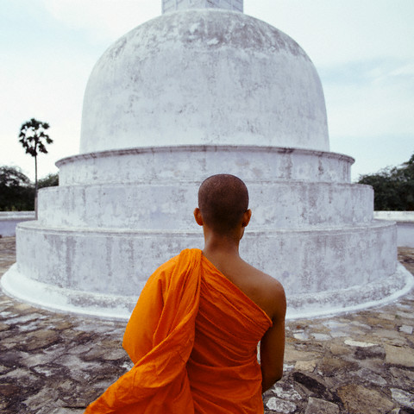
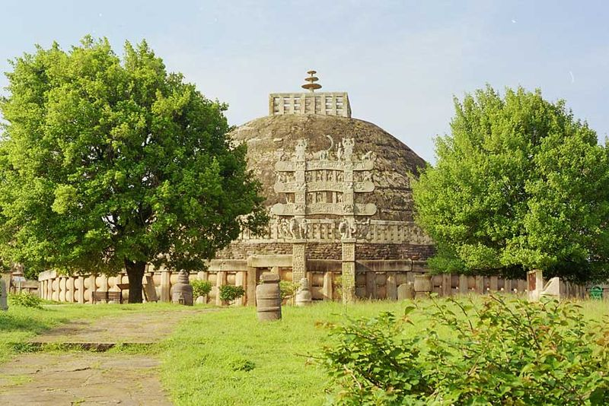
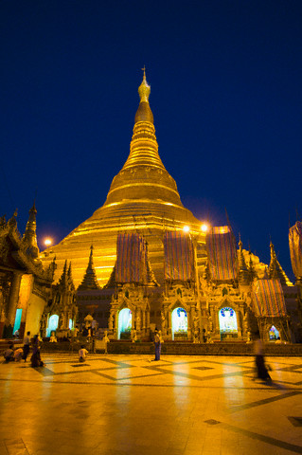
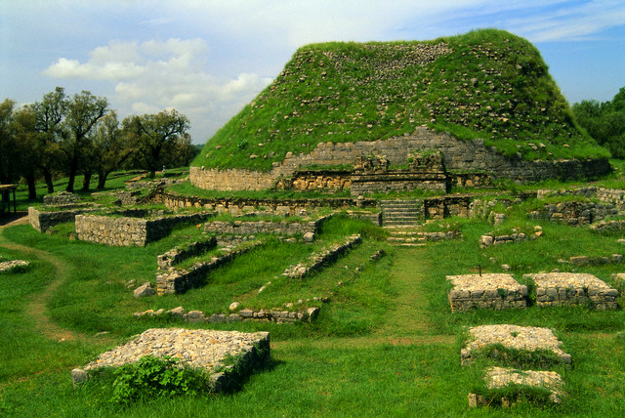
Stupa
Shrine that houses Buddhist relics

Slide 32
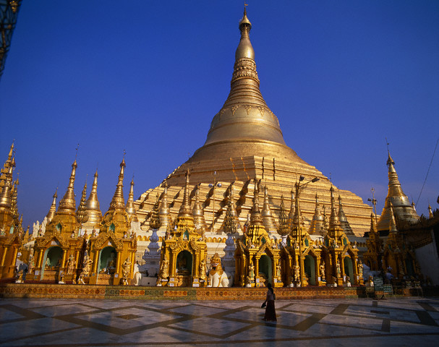
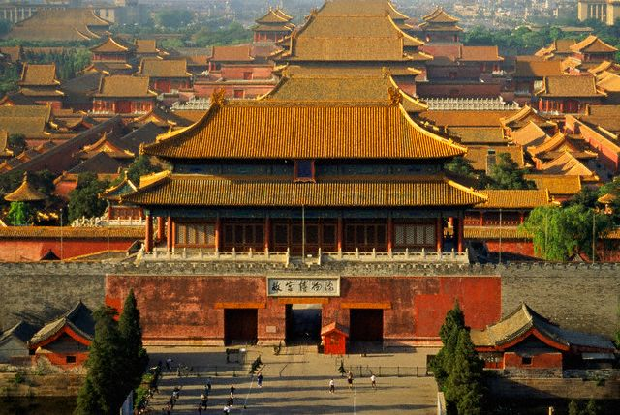
Pagodas
Evolved from Stupas, they are usually Buddhist temples or shrines

Slide 33
Caste System
Caste | Occupation | Function
Brahmins | Priests | Led religious ceremonies
Kshatriyas | Warriors | Fighting
Vaisyas | Merchants | Herdsmen, carried out trade
Sudras | Peasants | Manual labor
Untouchables (OUTSIDE CASTE SYSTEM) | Slaves/criminals | Menial, degrading tasks

