Slide 1
The Industrial Revolution

Slide 2
The Industrial Revolution
Refers to the enormous economic and political changes that took place in the mid-18th century as Europeans began to mass-produce products that were formerly hand-made in cottage industries.

Slide 3
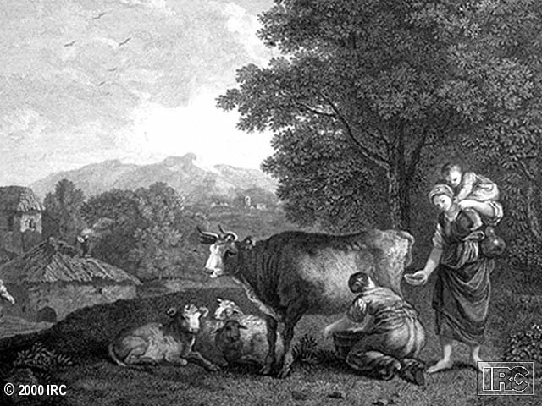
JEngCow
European life before the Industrial Revolution

Slide 4
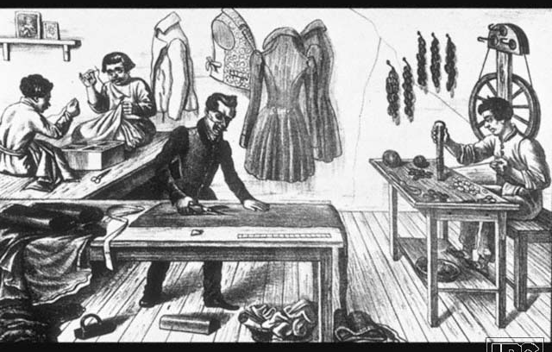
118Eng.Tailor
European life before the Industrial Revolution

Slide 5
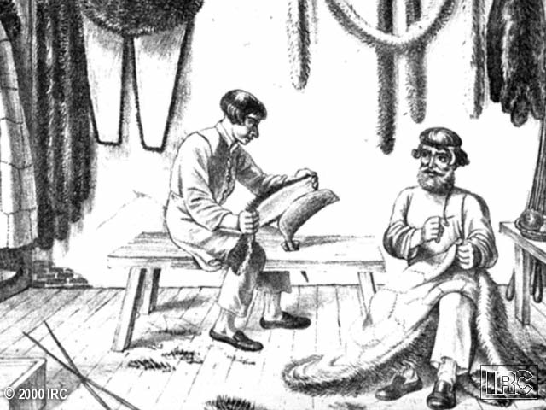
123Ferrier
European life before the Industrial Revolution

Slide 6
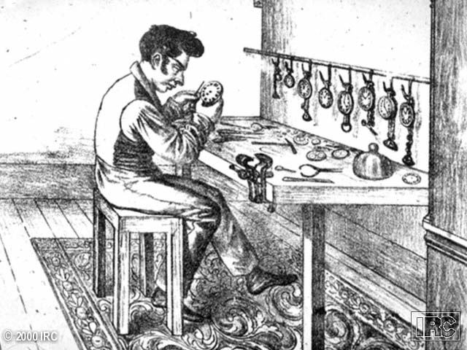
124Watchrepair
European life before the Industrial Revolution

Slide 7
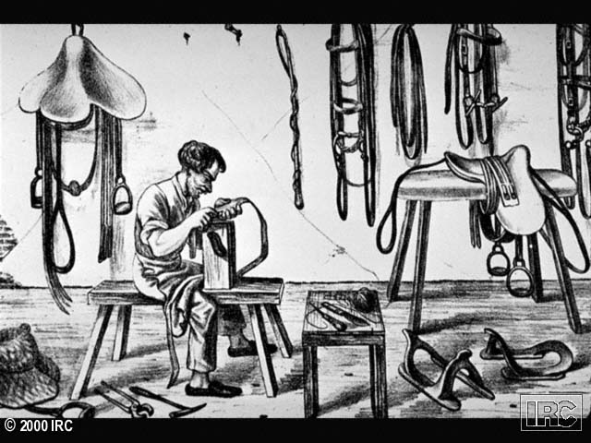
125Saddlemaker
European life before the Industrial Revolution

Slide 8
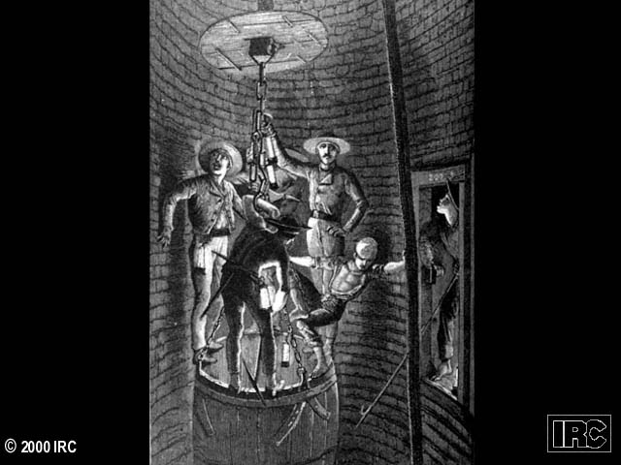
132Mineshaft
Early results of the Industrial Revolution: mine shaft

Slide 9
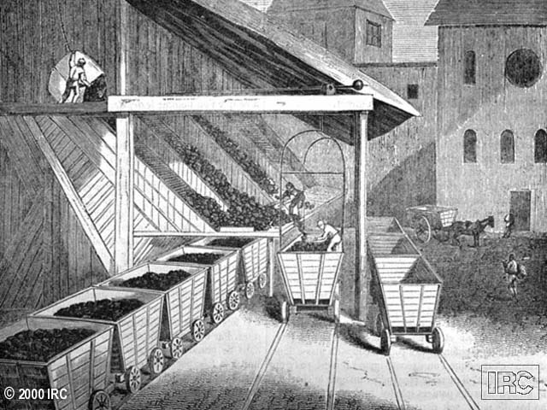
133Coalshaft
Early results of the Industrial Revolution: coal mine

Slide 10
Why did the Industrial Revolution begin in England?
• Stable & supportive government
• Many resources within a vast empire
• Superb Navy to protect the merchant fleet
• High quality sheep for wool supplies
• Rich supply of Coal

Slide 11
Early Inventions
James Hargreaves’ spinning jenny
John Kay’s flying shuttle
James Watt’s Steam Engine

Slide 12
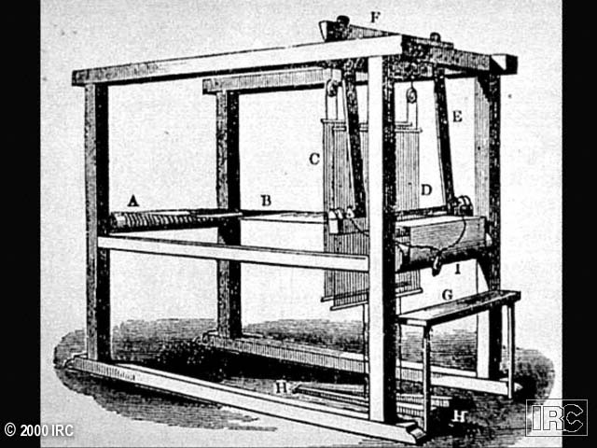
151J.KayFlyingSh
Early inventions: 1733- John Kay’s flying shuttle (for weaving)

Slide 13
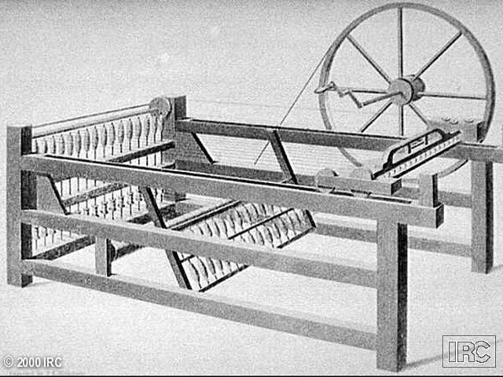
152JamesHarg.SpJen
Early inventions: John Kay’s flying shuttle (for weaving)

Slide 14
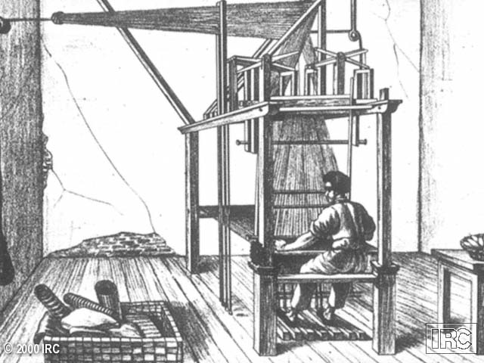
153JamesH ?????

Slide 15
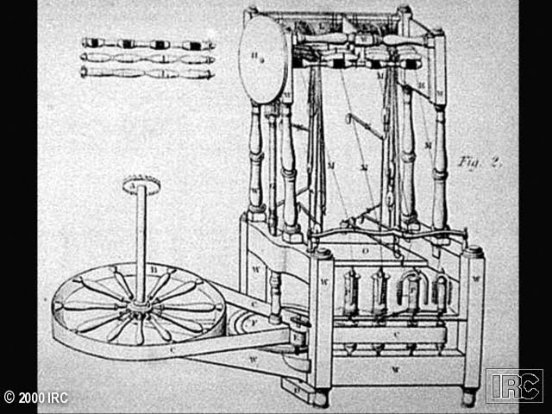
155R.A.Spin.Frame
1764- Early inventions: spinning frame

Slide 16
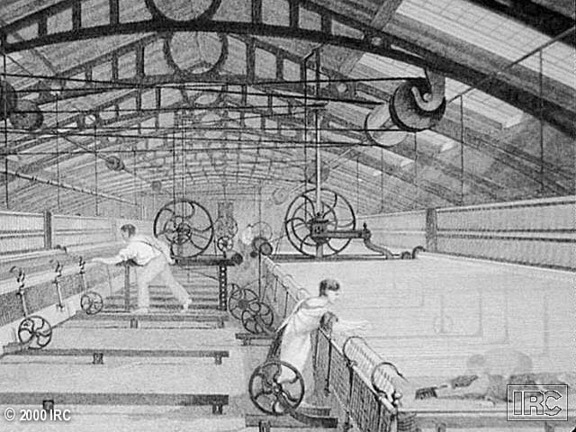
156Sam.Crompton
Early Factory- notice the “repairman”

Slide 17
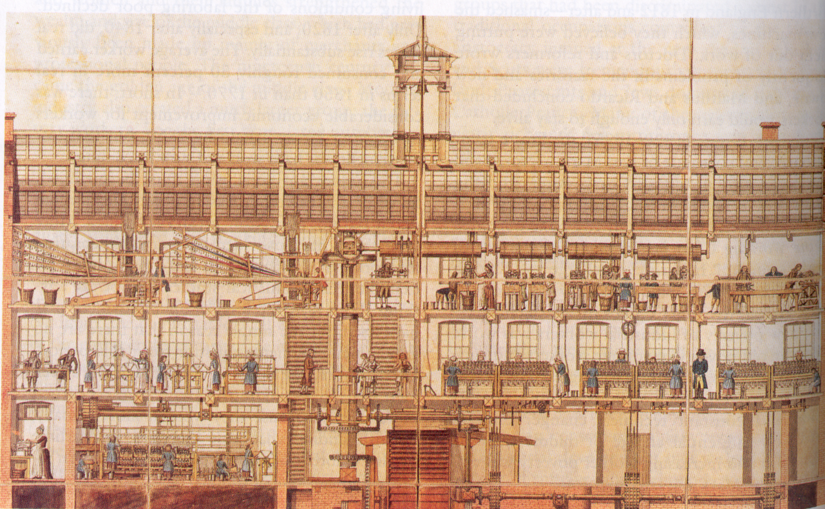
Textile Factory

Slide 18
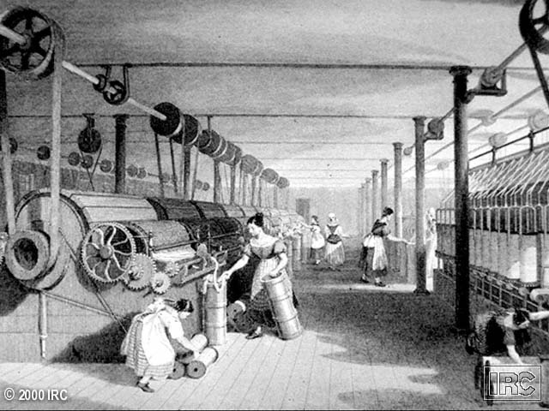
150CottonFACTORY
Cotton factory with child labor

Slide 19
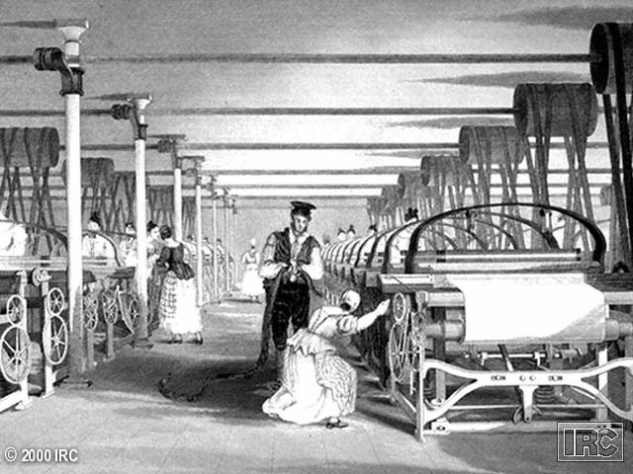
158PowerLoom
1787 Edmund Cartwright: Power Loom (water power)

Slide 20
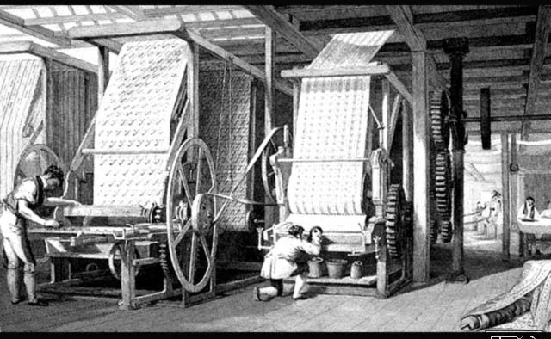
Printing cloth

Slide 21
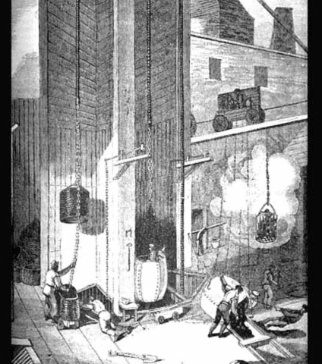
1765-
James Watt
invented a
Steam Engine

Slide 22
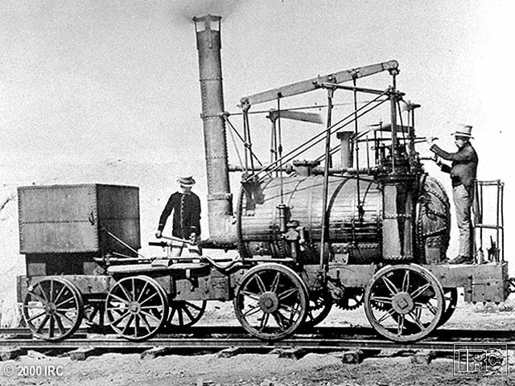
164BritLocomotive
Steam locomotive

Slide 23
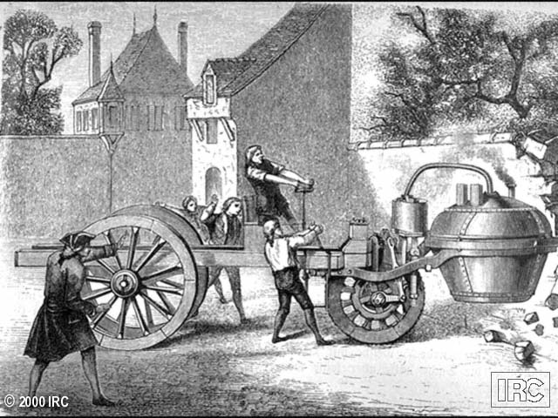
168SteamTractor
Steam Tractor

Slide 24
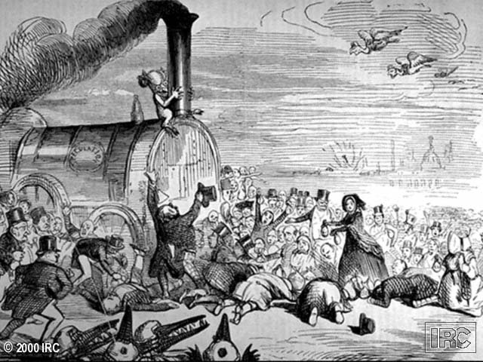
166RR
Early results of the industrial revolution: railroad transportation

Slide 25
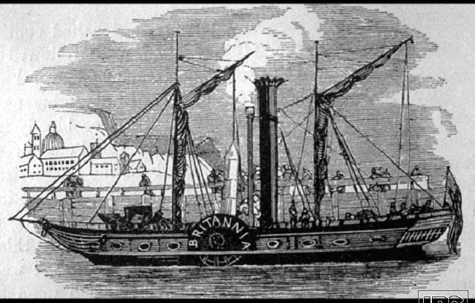
170St.Ship
Steam Ship

Slide 26
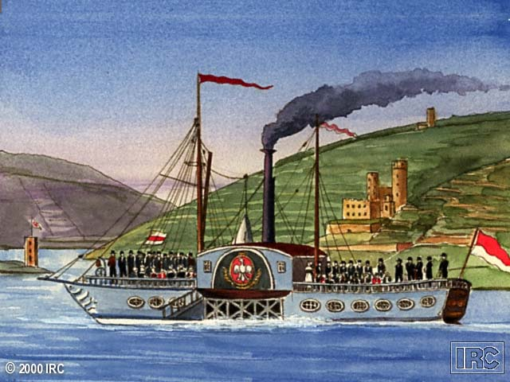
171FrankfurtStBt

Slide 27
“Wretched” Working Conditions
Child Labor
Low salaries
Unsafe conditions
Long hours
No unemployment insurance
No workmen’s compensation
Crowded/unsanitary tenement houses

Slide 28
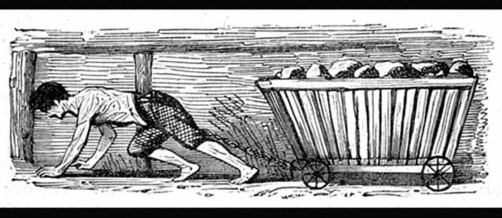
Child labor in coal mines

Slide 29
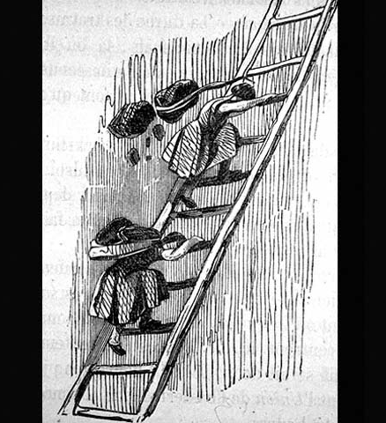
182GirlCoalminer
Child labor
in coal mines.

Slide 30
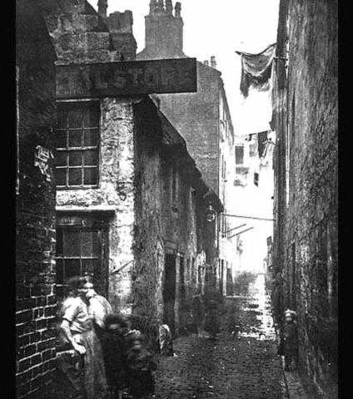
K152slums
Crowded, unsanitary
conditions in
tenement houses
for the proletariat
(working class)
as a result of the
industrial revolution.

Slide 31
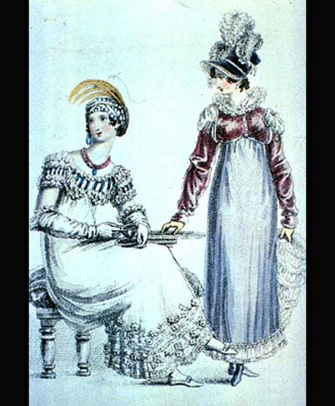
189LondonRich
The bourgeosie
(upper middle class)
that owned the
factories became
wealthy & enjoyed
a wide variety of
luxuries as a result
of the industrial
revolution.

