Slide 1
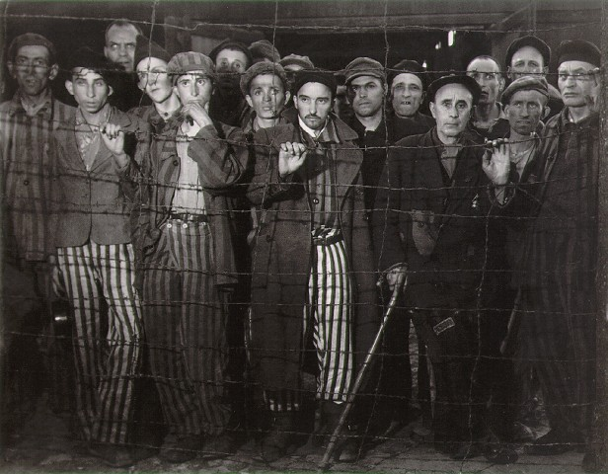
The Holocaust
A Brief Introduction

Slide 2
holocaust (noun):
Greek word meaning “sacrifice by fire”
The Holocaust (proper noun):
The Holocaust was the systematic, bureaucratic, state-sponsored persecution and murder of approximately six million Jews by the Nazi regime and its collaborators.

Slide 3
genocide (noun):
The crime of destroying a group of people because of their ethnic, national, racial, or religious identity
Nazi target groups:
Ethnicities: Jews & Gypsies (Roma),
Nationalities: Slavs (Poles & Russians)
“Degenerates”: homosexuals,
the mentally & physically disabled
Political rivals: communists & socialists
Religions: Jehovah Witnesses & Jews
Asocials: Anybody else who opposed the Nazis

Slide 5
They came for the Communists,
and I didn't object
- For I wasn't a Communist;
They came for the Socialists,
and I didn't object
- For I wasn't a Socialist;
They came for the labour leaders,
and I didn't object
- For I wasn't a labour leader;
They came for the Jews,
and I didn't object
- For I wasn't a Jew;
Then they came for me
And there was no one left
to object. Martin Niemoller, (1892-1984 )
German Protestant Pastor, & Nazi Political Prisoner from 1937 to 1945

Slide 6
Escalation of Hate
Institutionalized, government sponsored racism
Genocide
Discrimination
Prejudice
Stereotyping

Slide 7
Eugenics
Based loosely on early 20th century understanding of the science of genetics, eugenicists believed that people should be bred as farmers breed animals: deliberately weeding out “inferior” traits through genetic selection. The Nazis believed that they could create a “a master race”.

Slide 8
Aryan Race
The Nazis believed that people of Northern European ancestry – especially those with blue eyes and blonde hair – were superior to all other people, including people of African, Asian, and Middle-Eastern ancestry.
In 1933, there were few people of African or Asian ancestry living in Germany. There were, however, 500,000 Jews who seemed to threaten “racial purity”.

Slide 9
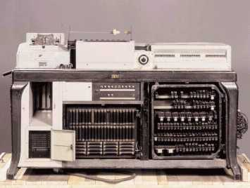
How did they know who was Jewish?
November 1935 German churches begin to collaborate with Nazis by supplying records indicating who is Christian
State of the art data processing was used to take a census in all German territory. Early on the Nazis included questions on religious heritage
The machine allowed Nazi officials to tabulate huge amounts of data very quickly
German Hollenith Machine – a subsidiary of IBM

Slide 10
How did they know who was Jewish?
In 1934, Nazi scientists developed
This kit, which contained 29 samples of human hair. The samples were used by geneticists, anthropologists, and doctors to determine ancestry. Hair colour also became a means to prove the supposed superiority of Aryans and the inferiority of Jews, Gypsies, and those of “mixed breeds”.

Slide 11
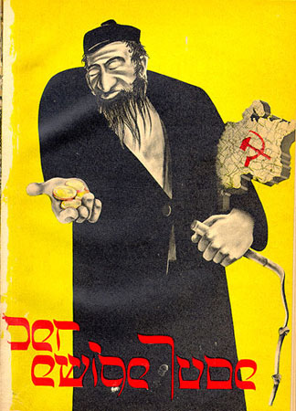
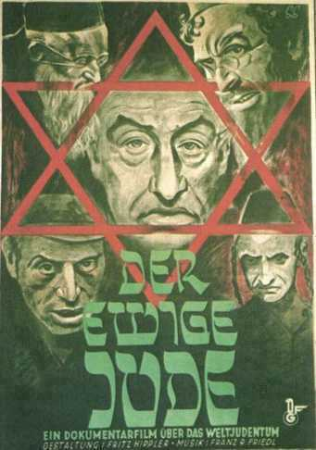

Slide 12
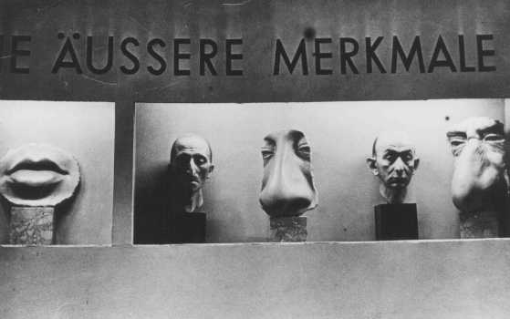

Slide 13
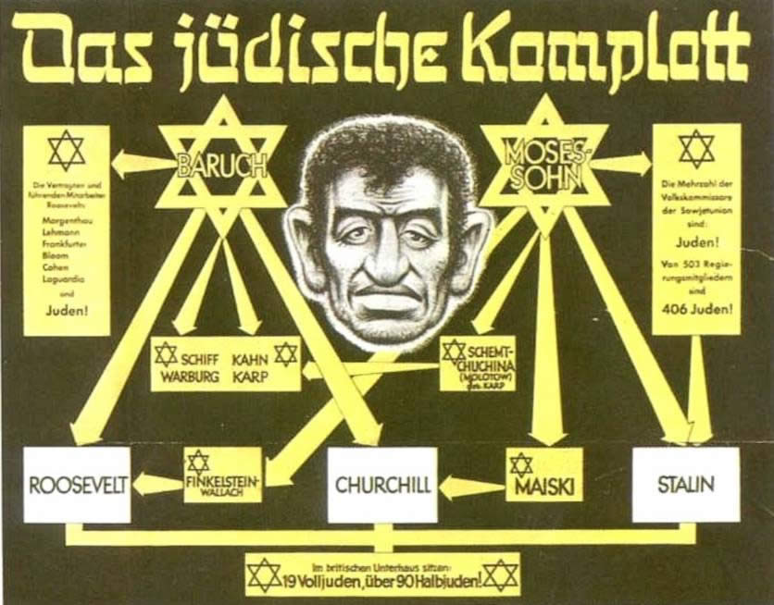

Slide 14
Escalation
April 1933 – One-day boycott of Jewish shops
May 1933 – burning of Jewish books
“Nuremberg Laws”
1935: Jewish newspapers banned
1936: Jews lose right to vote
1938: Jews surrender drivers’ licenses and car registrations; Jews required to carry ID cards
1938: Kristallnacht (“The Night of Broken Glass”)

Slide 15
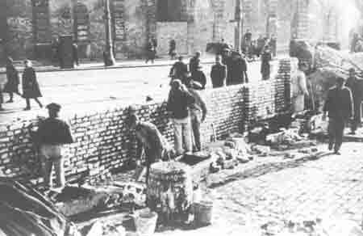
Steps to the Concentration Camp
Denied rights
Forced to always identify themselves as Jewish
Forced to live in “Jewish Quarters” or ghettos (separate from the rest of the city)

Slide 16
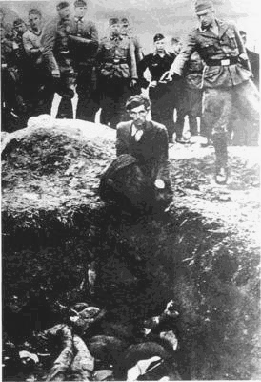
Sporadically Killed
Einsatzgruppen: mobile killing units that would go to towns, round up the Jews, force them to dig an open pit, and then shoot them.
Killed as many as 1 million people in a span of 6 months
However, this is costly and inefficient…

Slide 17
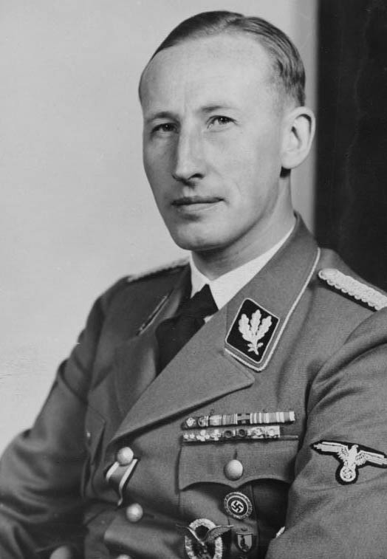
SS Major General Reinhard Heydrich
Asked by Hitler to prepare “a total solution of the Jewish question… in ways that go beyond emigration and evacuation.”

Slide 18
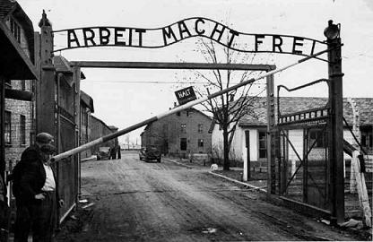
Systematically annihilated: “The Final Solution”
The code name for the plan to destroy the Jews of Europe. In December, 1941, Jews were rounded up -- under the excuse of a “resettlement” program -- and sent to death camps in the East.

Slide 19
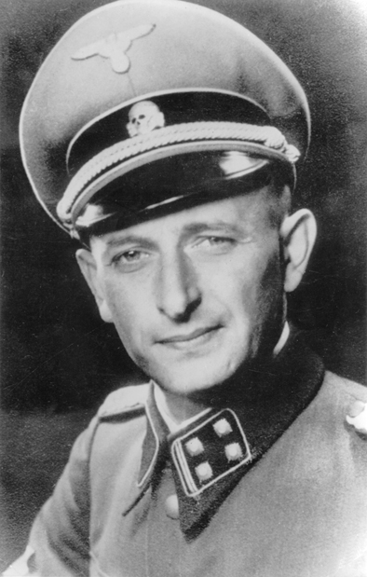
SS Officer Adolf Eichmann
Given the task of implementing the “Final Solution” (he had to figure out how to actually get it done).
An extremely efficient bureaucrat, he oversaw the round-ups and train convoys and eventually the use of poison gas to exterminate the prisoners.

Slide 20
Victims of the Holocaust
Victimes | Killed
Jews | 5.9 million
Soviet POWs | 2-3 million
Ethnic Poles | 1.8-2 million
Romani (Gypsies) | 220,000-1.5 million
Disabled | 200,000-250,000
Freemasons | 80,000-200,000
Slovenes | 20,000-25,000
Homosexuals | 5,000-15,000
Jehovah’s Witnesses | 2,500-5,000
Spanish Republicans | 7000

Slide 21
Annihilation of Europe’s Jewish Population
Country | Estimated Killed | Percentage of Jewish Population
Poland | 3,000,000 | 90%
Baltic countries | 228,000 | 90%
Germany and Austria | 210,000 | 90%
Bohemia and Moravia | 80,000 | 89%
Slovakia | 75,000 | 83%
Greece | 54,000 | 77%
Netherlands | 105,000 | 75%
Hungary | 105,000 | 70%
Belgium | 40,000 | 60%
Yugoslavia | 26,000 | 60%
Romania | 300,000 | 50%
Norway | 890 | 41%
France | 90,000 | 26%

Slide 22
Impact of the Holocaust
“Never Again”
1945-1946: Nuremberg Trials – punishment of high-ranking Nazi officials
Jews want a country of their own – why?
Many emigrate to Palestine
1948: creation of Israel by the United Nations

Slide 23
How could so many people have been involved in such a horrific act?

Slide 24
How could so many people have been involved in such a horrific act?
“We were brainwashed.”
https://www.youtube.com/watch?v=D8bCuNiJ-NI

Slide 25
How could so many people have been involved in such a horrific act?
“We were just following orders.”
https://www.youtube.com/watch?v=yr5cjyokVUs

