Slide 1
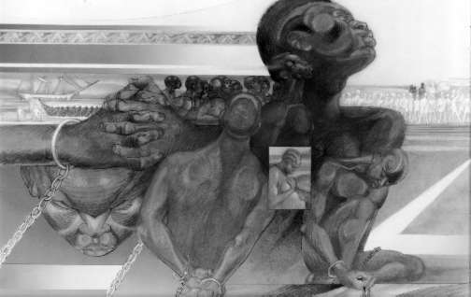
Origins of Slavery in the Americas

Slide 2
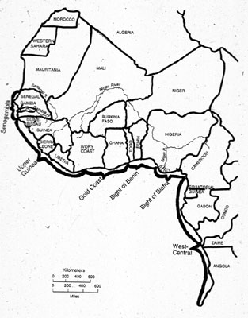
West Africa
Most slaves were captured and bought in West Africa
West Africa was home to the Ancient Kingdoms of Mali and Ghana among others
Originally European outposts in West Africa traded for spices/gold

Slide 3
West Africa
Europeans upon their first encounters with Africans respected African cultures and people
Europeans needed labor after the discovery of the Americas and attitudes shifted
Europeans began to look at Africans as unintelligent savages

Slide 4
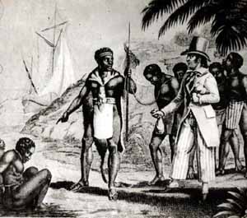
Capture
Europeans rarely captured slaves themselves
Europeans traded for slaves from local Kings
Slaves were gained through wars between Africans living on the coast and those living inland

Slide 5
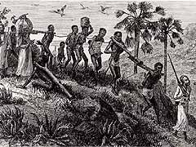
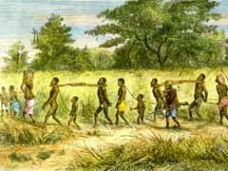
Capture
Europeans would provide coastal peoples with firearms insuring victory
Once captured enslaved Africans would be marched hundreds of miles to the coast
Often did not know where they were going
Many died of dehydration, exhaustion, and hunger, others were killed for insubordination, others killed themselves rather than continue on

Slide 6
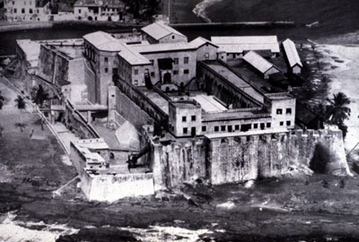
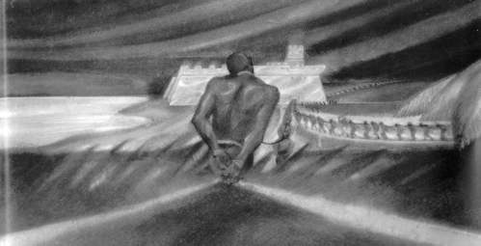
The Coast
Frightened of the Ocean
Put into “factories” the headquarters of the Europeans
Separated from families and even those who could speak their language
Examined naked by doctors, those who were “fit” were branded on their chests

Slide 7
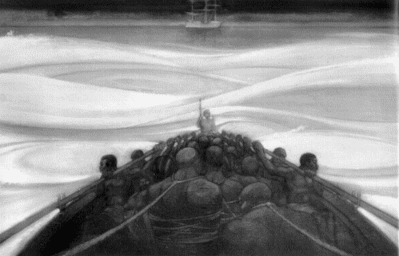
The Coast
Those who were “fit” were put on small boats to be taken to “slavers” or large shipping boats
Many believed they were being taken to cannibals who would eat them
Many jumped off the rowboats and committed suicide prior to making it to the large boats.

Slide 8
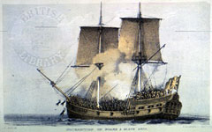
The Middle Passage
Average time 2-3 months though the largest ships could take only 40 days and the smallest could take up to 6 months
Boats were usually small and narrow
The formula for the number of enslaved people a ship could carry was 2 people per ton (the weight of the ship).

Slide 9
Middle Passage-Packing the Ship
Two theories of transporting enslave people- “loose packing” and “tight packing”
Loose packers wanted to keep their human cargo light, lower mortality rates, less rebellion
Most were “tight packers” they figured that though the mortality rate was higher they started out with more and would still end up with more saleable people in the end

Slide 10
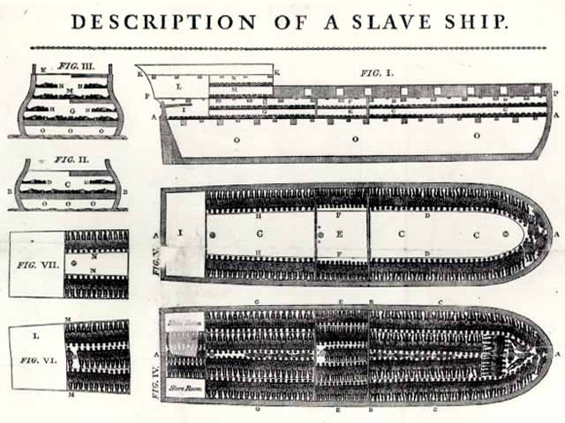
Middle Passage-Ship Conditions
Cargo space was usually 5 ft. high, divided in half by shelves
Each person was allowed an area 16 in. wide and 5 1/2 ft. long
There was only about 25 in. of head room
Males were chained together in pairs to prevent rebellion & separated from women and children

Slide 11
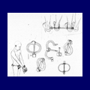
Middle Passage-Ship Conditions
People would crush each other when the ship rolled
So many people that air was suffocating
People would be chained to the dead
There would be bathroom buckets for every section

Slide 12
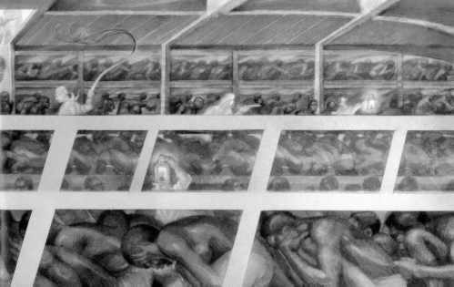
Middle Passage-Ship Conditions
Food-Vegetable porridges, stew
Fed twice a day
Poor nutrition caused many to die
Weakened immune systems
Wouldn’t feed the weak or ill

Slide 13
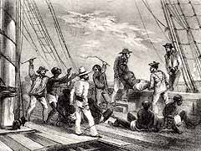
Middle Passage-Ship Conditions
The sick and ill were thrown overboard
Many chose to jump overboard or throw infant children overboard
Slave ships could be smelled from over 2 miles away due to the illness and death

Slide 14
Middle Passage-Ship Conditions
So many of the dead and living were thrown, or jumped, overboard that sharks would follow the slave ships for miles waiting for people to eat.

Slide 15
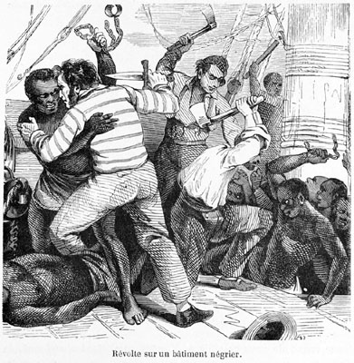
Middle Passage-Resistance
Methods of Resistance
Refusal to eat
Throw themselves overboard
Full out rebellion and mutiny
Methods of Ending Resistance
Tooth spreaders, coals
Beatings
Psychological torture
Separation of families and people who speak the same language

Slide 16
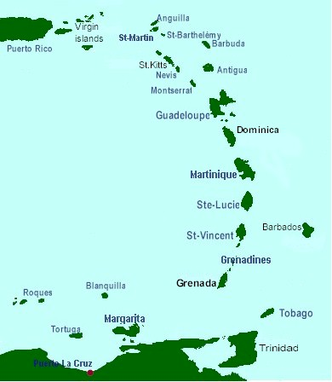
Arrival in the West Indies
Due to poor treatment most enslaved people arrived in the Americas ill and malnourished
A layover period in the westernmost islands allowed the enslaved people a chance to become more healthy
Slave traders rubbed their charges with oil and blackened their hair with shoe polish to make them appear healthy

Slide 17
Sales
Some buyers would take an entire shipment
If no buyers from the beginning, then auctions would be held on the ship or in the market place
Other times the enslaved Africans would be placed in a corral and people would rush through and gather as many as they could pay for tying them together.

Slide 18
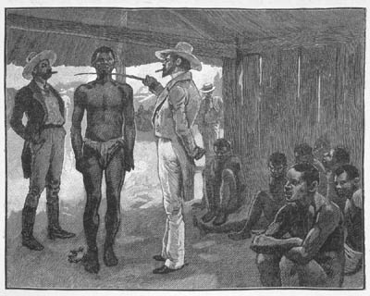
Sales-Inspections
Before sales Africans would have to go through intense inspections
The Africans would be poked and prodded, their teeth, eyes, and noses would be examined

Slide 19
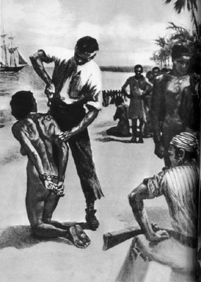
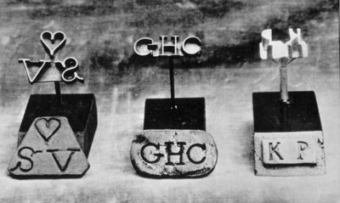
Sales-Completion
Once a person had been bought they were branded with the initials or symbol of the person who had purchased them

Slide 20
Seasoning
After purchase the enslaved Africans would be “seasoned” in the West Indies
They were given Christian or Greek Names
They were taught how to work on the plantations
The plantation owners tried to break the will of the Africans

Slide 21
Why didn’t Africans get European Diseases?
Previous Trade- Africans were used to European diseases

Slide 22
Why Africans and not Native Americans
Africans
Native Americans
Immune to diseases and germs of Europeans
Experienced Farmers
Little opportunity for escape- didn’t know the land and had nowhere to run to
Skin Color made it impossible to hide
80-90% of these societies died of European germs
Experienced Farmers
They knew the land and could escape and live as a free person far away
The color of their skin did not distinguish them as slaves

Slide 23
The Triangular Trade
The boats would start in Europe and would gather rum and guns to take down to Africa to sell for a profit.
Once the boats were empty…
Europe
Africa
North America

Slide 24
The Triangular Trade
Boats were filled up in Africa with captives
They were taken across the Middle Passage to the Americas
The slaves’ job in America was to…
Europe
Africa
North America

Slide 25
The Triangular Trade
In the Americas, slaves were used to grow and harvest cash crops
Tobacco, Sugar, Cotton
These goods were loaded onto a boat and sold in Europe
Europe
Africa
North America

Slide 26
Survival in the New World
Music, food, religion, art, language
Resistance- breaking tools, destroying crops, working slow
Ran away
Rebellions/Revolts: Death to the owners

Slide 27
Consequences to Africa
The fittest population of Africa was moved to the Americas
Families are torn apart
Guns are in Africa, which leads to warring
Torment and discrimination lasts for centuries

