Slide 1
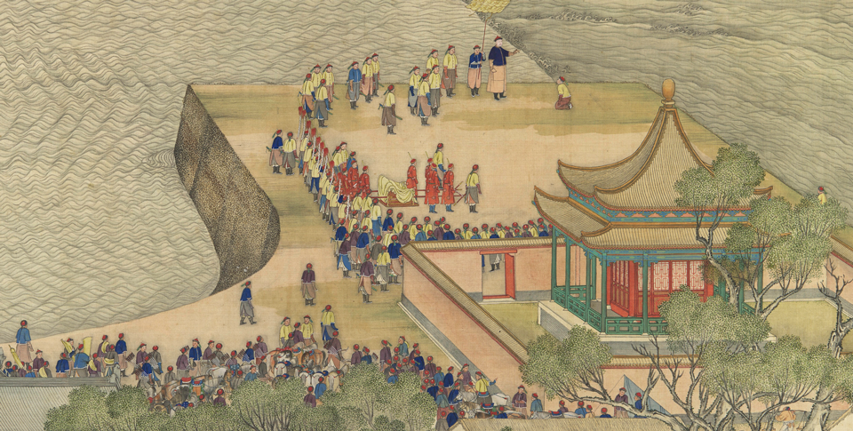
Ancient India and China (2600 B.C.-A.D. 550)
Lesson 4 Ancient Civilization in China

Slide 2
Ancient India and China (2600 B.C.-A.D. 550)
Lesson 4 Ancient Civilization in China
Learning Objectives
Understand how geography influenced early Chinese civilization.
Analyze how Chinese culture took shape under the Shang and Zhou dynasties.
Describe the origins, central ideas, and spread of Confucianism and Daoism.
List some achievements made in early China.

Slide 3
Ancient India and China (2600 B.C.-A.D. 550)
Lesson 4 Ancient Civilization in China
Key Terms
loess,
clans,
dynastic cycle,
Feudalism
Confucius
Laozi
philosophy,
filial piety,
oracle bones.
characters,
calligraphy.

Slide 4
Geography Influences Chinese Civilization
In ancient times, the Chinese depended on rivers for irrigation and transportation. They highly valued the ability to control floodwaters and to develop irrigation systems. The Chinese also prized devotion to duty. The importance they placed on these skills played a key role in the development of Chinese civilization.

Slide 5
Geography Influences Chinese Civilization
Geographic Barriers Set China Apart
The Varied Regions of China
Early Peoples Settle Along the “River of Sorrows”

Slide 6
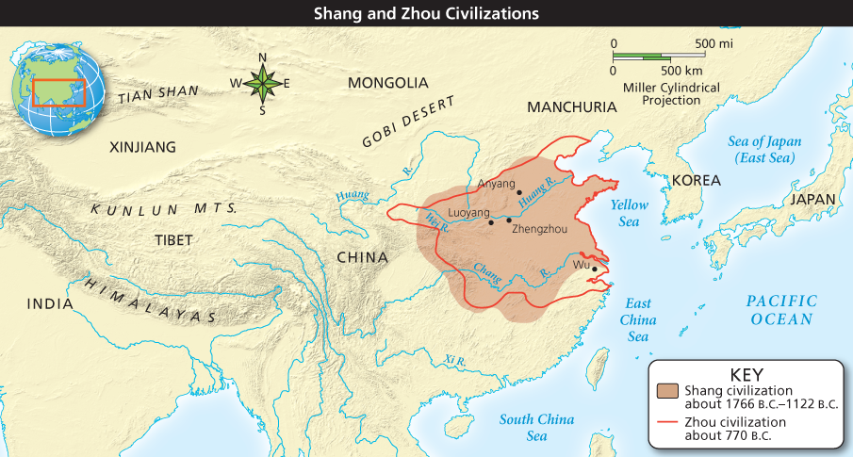
Geography Influences Chinese Civilization
Analyze Maps China’s geographic barriers made it difficult for both invaders and traders to make their way to the center of China’s emerging civilization. What physical features acted as obstacles to outside contact with China?

Slide 7
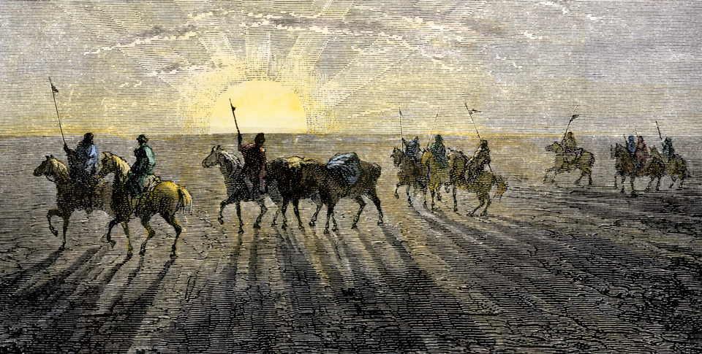
Geography Influences Chinese Civilization
Invading nomads traveling by camel and horseback crossed China’s northern deserts. These nomads eventually became part of Chinese civilization.

Slide 8
The Shang Dynasty Begins to Form China
About 1766 b.c., the first Chinese dynasty for which scholars have found solid evidence arose in a corner of northern China. This dynasty, the Shang, would dominate the region until about 1122 b.c.

Slide 9
The Shang Dynasty Begins to Form China
Formation of Government
Social Classes Develop

Slide 10
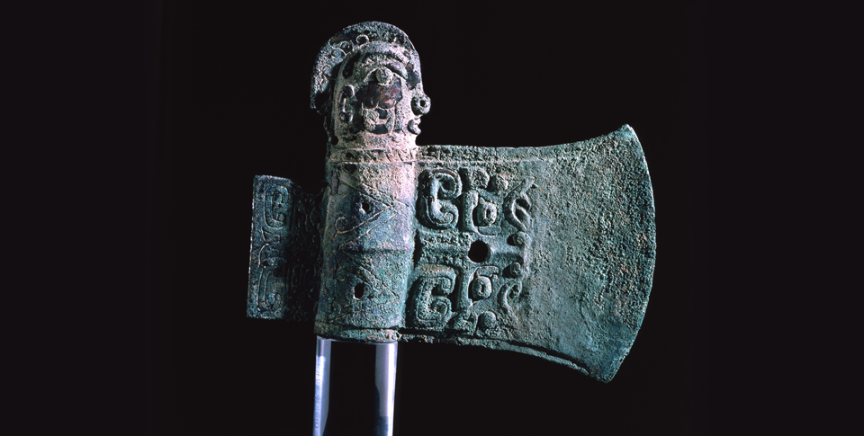
The Shang Dynasty Begins to Form China
Shang dynasty artisans were skilled in creating detailed objects in a variety of materials, including bronze and jade. This is a ceremonial bronze axe head.

Slide 11
The Zhou Dynasty
In 1122 b.c., the battle-hardened Zhou (joh) people marched out of their kingdom on the western frontier to overthrow the Shang. They set up the Zhou dynasty, which lasted until 256 b.c.

Slide 12
The Zhou Dynasty
The Zhou Claim the Mandate of Heaven
A Feudal State Is Established
Economic Growth
Zhou Dynasty Ends

Slide 13
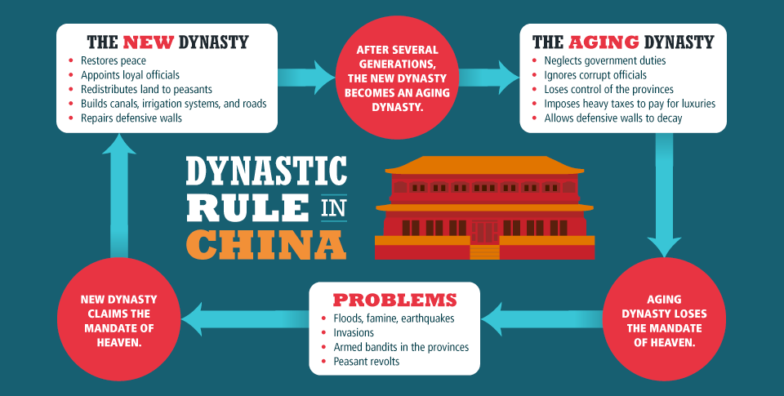
The Zhou Dynasty
Analyze Information What causes a dynasty to lose the Mandate of Heaven?

Slide 14
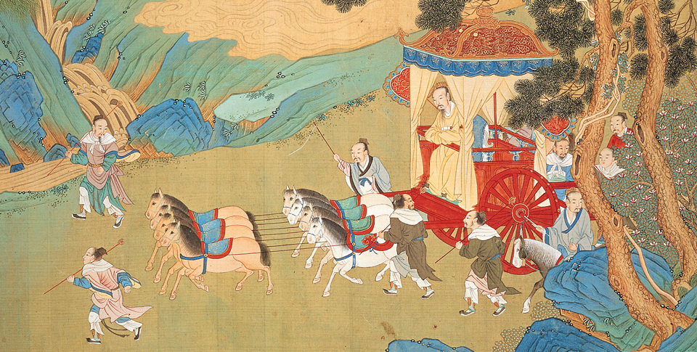
The Zhou Dynasty
Under the feudal system, feudal lords maintained their own armies and lands while owing military service to the Zhou king.

Slide 15
Religious Beliefs in Early China
By Shang times, the Chinese had developed complex religious beliefs, many of which continued to be practiced for thousands of years. The early Chinese prayed to many gods and nature spirits. Chief among them was the supreme god, Shang Di (shahng dee). The king was seen as the link between the people and Shang Di.

Slide 16
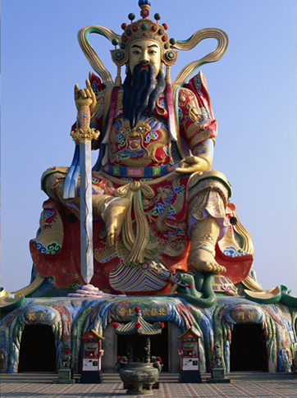
Religious Beliefs in Early China
Shang Di was considered the most powerful of the many gods worshiped in ancient China. This statue is in Taiwan.

Slide 17
Two Major Belief Systems Take Root
During the late Zhou period, when war and social changes were disrupting old ways of life, new belief systems developed that would form the basis of China’s culture and government for centuries to come. Thinkers such as Confucius (known by the Chinese as Kong Fuzi) and Laozi (LOW dzuh) put forward ideas on how to restore social order and maintain harmony with nature.

Slide 18
Two Major Belief Systems Take Root
Confucius Spreads His Wisdom
Five Relationships Shape Behavior
Confucianism Has Great Influence
Confucianism Spreads
Daoism Teaches Harmony With Nature
Confucianism and Daoism Evolve

Slide 19
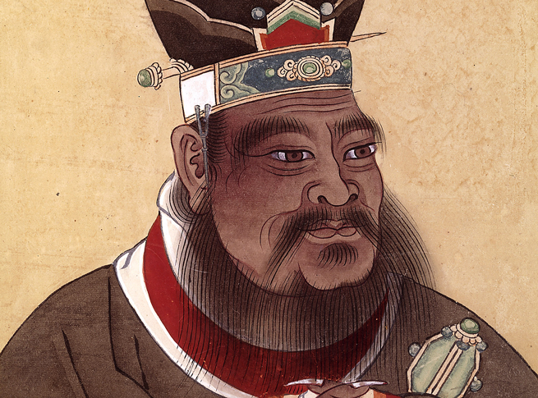
Two Major Belief Systems Take Root
A scholar and teacher, Confucius had an enormous cultural influence on early Chinese civilization.

Slide 20
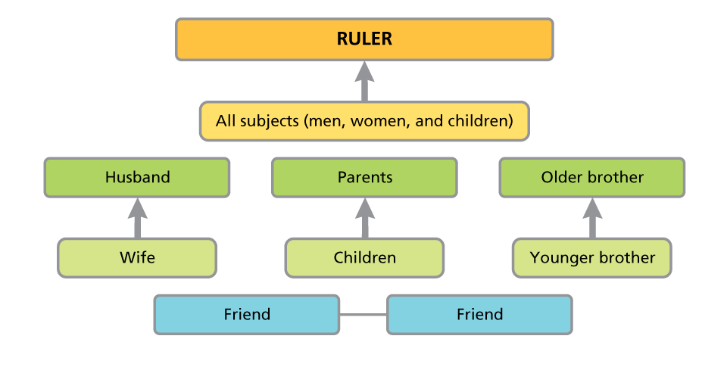
Two Major Belief Systems Take Root
Analyze Charts Confucius stressed the importance of five basic relationships that shape behavior. In most cases, these relationships are based on hierarchy. According to Confucius, what is the one relationship that is between equals?

Slide 21
A Time of Achievements in Early China
The people of Shang and Zhou China are known for numerous cultural achievements. For example, Shang astronomers studied the movement of planets and recorded eclipses of the sun. Their findings helped them develop an accurate calendar with 365 and ¼ days. In addition, the Chinese also improved the art and technology of bronze-making, producing stunning bronze weapons and ritual vessels covered with intricate decorations.

Slide 22
A Time of Achievements in Early China
Discovering the Secret of Making Silk
A Complex System of Writing Is Developed
Creating the First Books

Slide 23
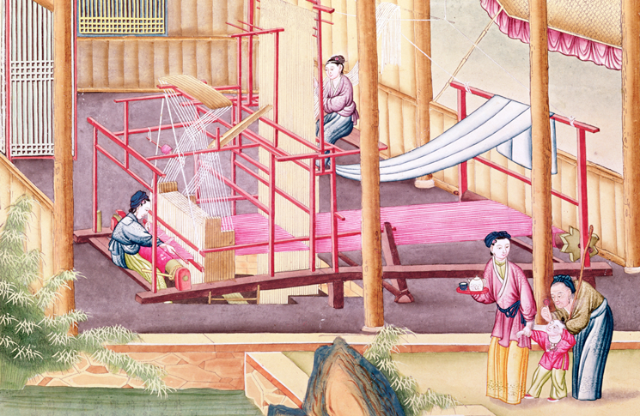
A Time of Achievements in Early China
Silk thread or silk woven into magnificent fabrics were key trading items for the Chinese. Because of this, the process of converting raw silk to smooth cloth was a closely guarded secret.

Slide 24
Quiz: Geography Influences Chinese Civilization
Loess was a problem for the people of the Huang River valley because it
A. caused constant dust storms and eroded good farming soil.
B. settled on the river bottom, causing the water to rise and flood.
C. tended to coat young plants, preventing the crops from growing properly.
D. contaminated the freshwater supply for most of the valley.

Slide 25
Quiz: The Shang Dynasty Begins to Form China
During the Shang dynasty, the country was governed by
A. an authoritarian king who controlled all of the kingdom.
B. a special priest class who consulted with the king.
C. a king and a council of nobles, priests, and commoners.
D. a king who controlled a small area and relied on nobles and princes to govern their areas.

Slide 26
Quiz: The Zhou Dynasty
The Zhou kings explained their right to rule as
A. the Mandate of Heaven.
B. reward for defeating the Shang armies.
C. the will of the people.
D. the basic rights of the strong over the weak.

Slide 27
Quiz: Religious Beliefs in Early China
What was the king’s relationship to Shang Di?
A. As the equal of the god, the king could grant the prayers of the people.
B. The king was the mortal presence on Earth of the god Shang Di.
C. The king was the link between the common people and Shang Di.
D. The king would translate visions he received from Shang Di.

Slide 28
Quiz: Two Major Belief Systems Take Root
Which of the following statements is an example of Confucianism?
A. All people should live according to the roles and responsibilities outlined in the five key relationships.
B. People should always seek to better themselves and not be limited by the circumstances of their birth.
C. Staying in harmony with nature is the key to a successful life.
D. People should seek to keep a certain level of separateness from everyday life.

Slide 29
Quiz: A Time of Achievements in Early China
What feature of Chinese writing helped people to understand it even if they spoke a different language?
A. Tens of thousands of characters allow for endless ways of putting them together so they can form words in any language.
B. The many thousands of characters represent whole words or ideas.
C. The characters of the Chinese alphabet were common to all languages so could be understood by anyone.
D. The Chinese continually added characters to the written language so that all spoken languages could be reproduced.

