Slide 1
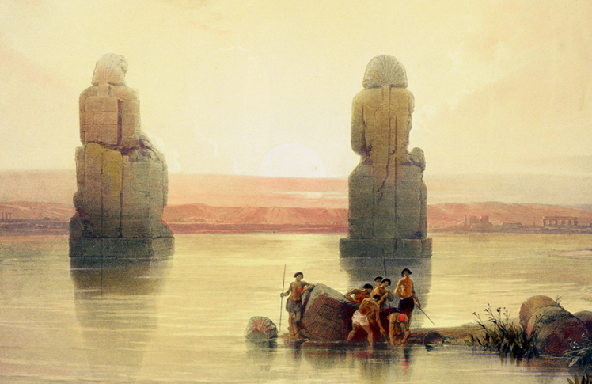
The Ancient Middle East and Egypt (3200 B.C-500 B.C)
Lesson 4 Egyptian Civilization

Slide 2
The Ancient Middle East and Egypt (3200 B.C-500 B.C)
Lesson 4 Egyptian Civilization
Learning Objectives
Understand the ways in which geography helped shape ancient Egypt.
Explain how Egypt grew strong during the New Kingdom.
Describe the ways in which religious beliefs shaped the lives of ancient Egyptians.
Explain how the Egyptians organized their society.
Outline the advances that the Egyptians made in learning, the arts, science, and literature.

Slide 3
The Ancient Middle East and Egypt (3200 B.C-500 B.C)
Lesson 4 Egyptian Civilization
Key Terms
cataract,
delta
dynasty,
pharaohs
Osiris
Isis
mummification
hieroglyphics
papyrus
deciphering,
Rosetta Stone.

Slide 4
Geography Shapes Egypt
The fertile lands of the Nile Valley attracted Stone Age farmers. People migrated there from the Mediterranean area, from hills and deserts near the Nile, and from other parts of Africa. In time, a powerful civilization emerged that depended heavily on the control of river waters.

Slide 5
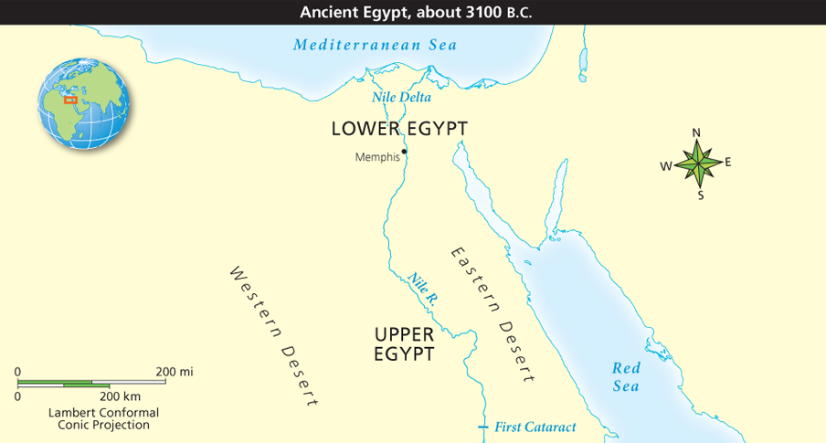
Geography Shapes Egypt: What are the benefits of flooding?
Analyze Maps The Nile extends another 3,600 miles south of its first cataract. What geographic features might have limited the expansion of civilization beyond the Nile Valley?

Slide 6
Geography Shapes Egypt: What are the disadvantages of flooding?
These statues at Thebes stood in front of a temple destroyed by the Nile’s flooding. Egyptians learned to control the flooding and use the Nile for agriculture as well as transportation.

Slide 7
The Old Kingdom
Scholars divide the history of ancient Egypt into three main periods:
Old Kingdom (about 2575 B.C.–2130 B.C.)
Middle Kingdom (about 1938 b.c.–1630 B.C.)
New Kingdom (about 1539 B.C.–1075 B.C.).
Although power passed from one dynasty, or ruling family, to another, the land generally remained united.

Slide 8
The Old Kingdom
A Structured Government
Building the Great Pyramids

Slide 9
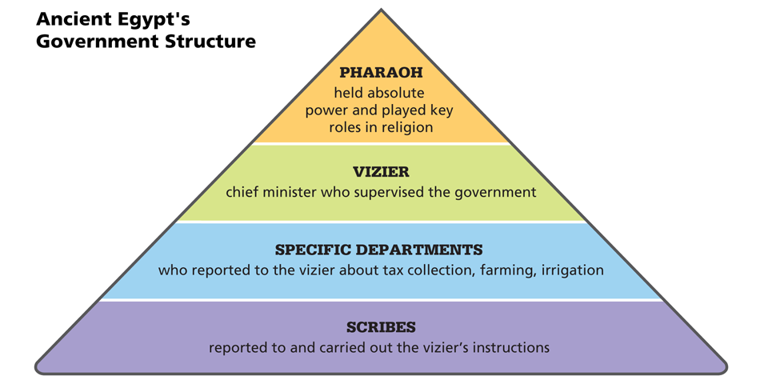
The Old Kingdom
Analyze Information According to the information in this chart, what did the vizier do?

Slide 10
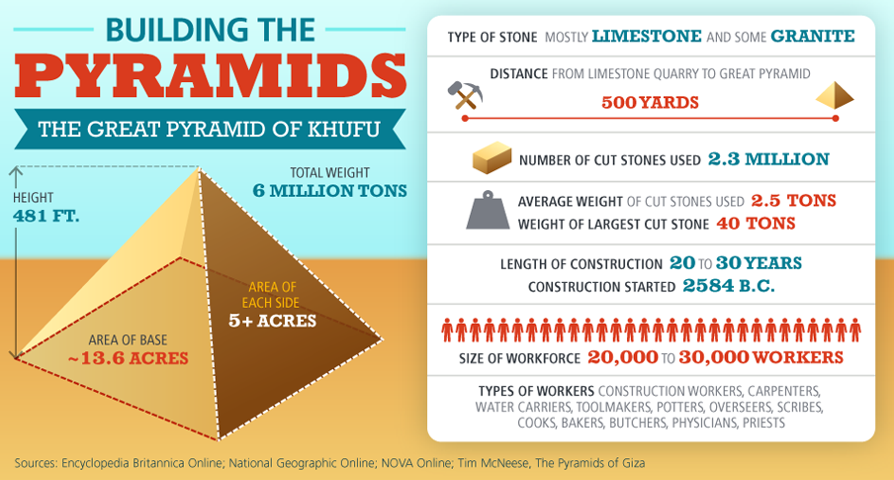
The Old Kingdom
Analyze Data Pharaohs spent a great deal of resources and time building pyramids. Based on the information here, why do you think Giza pyramids built after Khufu’s were not as large as his?

Slide 11
Middle and New Kingdom Egypt
Power struggles, crop failures, and the cost of building the pyramids all contributed to the collapse of the Old Kingdom.
Then, after more than a century of disunity, new pharaohs reunited the land, ushering in a new era, the Middle Kingdom.

Slide 12
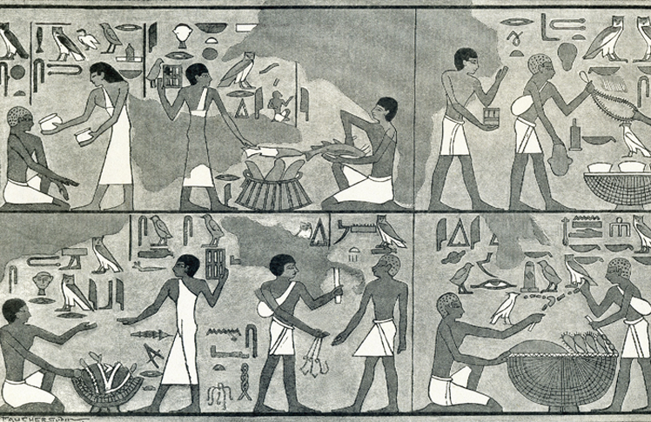
Middle and New Kingdom Egypt
In ancient Egyptian marketplaces, farmers and craftsmen set up stalls to sell their products. Ancient Egyptians did not use money, so all purchases were trades.

Slide 13
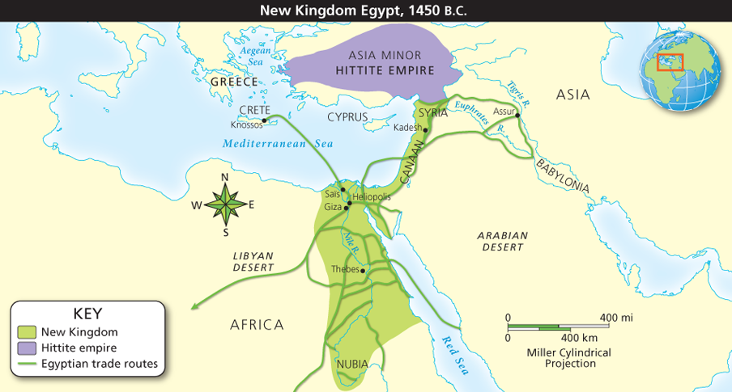
Middle and New Kingdom Egypt
Analyze Maps During the New Kingdom, Egypt extended its trade routes and made peace with the Hittites to the north. How do you think the alliance with the Hittites helped Egypt reach its greatest extent?

Slide 14
Religion Shapes Ancient Egyptian Life
Religious beliefs about gods, values, and life after death affected the daily lives of ancient Egyptians. Today, much of what we know about Egyptian religion comes from inscriptions on monuments and wall paintings in tombs. These inscriptions describe Egyptians appealing to the divine forces that they believed ruled this world and the afterlife.

Slide 15
Religion Shapes Ancient Egyptian Life
Important Gods and Goddesses
Egyptian Views of the Afterlife
Mummification
King Tutankhamen’s Tomb

Slide 16
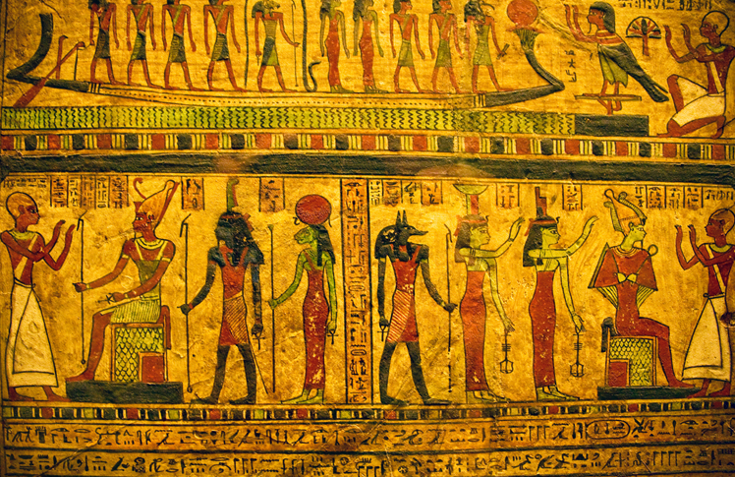
Religion Shapes Ancient Egyptian Life
The ancient Egyptians believed in many gods and goddesses, each of whom had a role in maintaining peace and prosperity across Egypt.

Slide 17
Social Classes of Egyptian Society
Like other early civilizations, Egypt had its own class system.
As both a god and an earthly leader, the pharaoh stood at the top of society, along with the royal family.
Directly under the pharaoh were government officials and the high priests and priestesses, who served the gods and goddesses.
Next came a tiny class of merchants, scribes, and artisans. They provided for the needs of the rich and powerful.
The bottom layer of society was the largest—made up of peasants who worked the land. (Most of the people!)

Slide 18
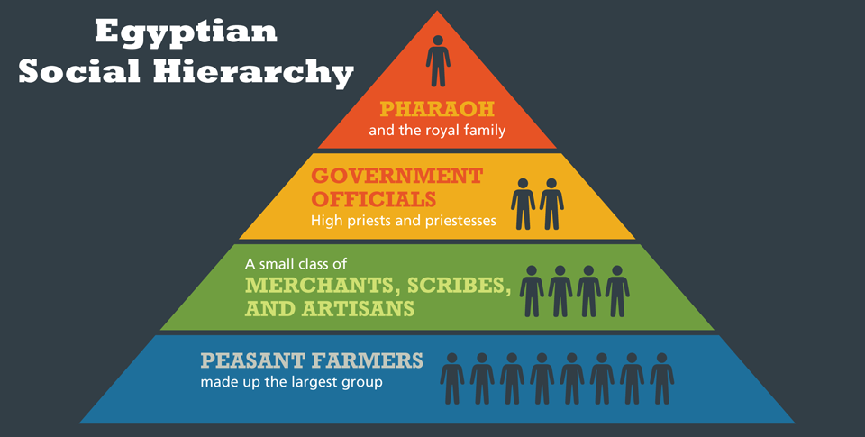
Organization of Egyptian Society
Analyze Information What does the structure of Egypt’s class system tell you about the importance of religion in that society?

Slide 19
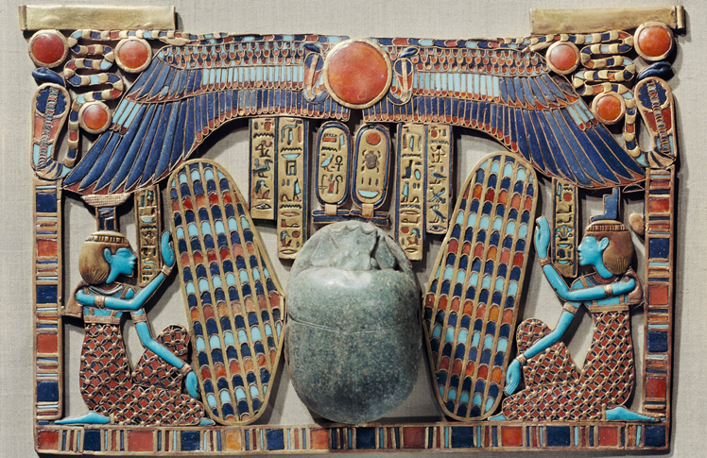
Organization of Egyptian Society
Most of the surviving ancient Egyptian art, like the artwork shown here, comes from tombs and monuments and emphasizes life after death and the preservation of past knowledge.

Slide 20
Egyptian Learning Advances
Learned scribes played a central role in Egyptian society. Some kept records of ceremonies, taxes, and gifts. Others served government officials or the pharaoh. Scribes also acquired skills in mathematics, medicine, and engineering. With skill and luck, a scribe from a poor family might become rich and powerful.

Slide 21
Egyptian Learning Advances
Written Records
The Rosetta Stone Unlocks Egyptian Writing
Egyptian Science and Mathematics
Egyptian Arts
Egyptian Literature

Slide 22
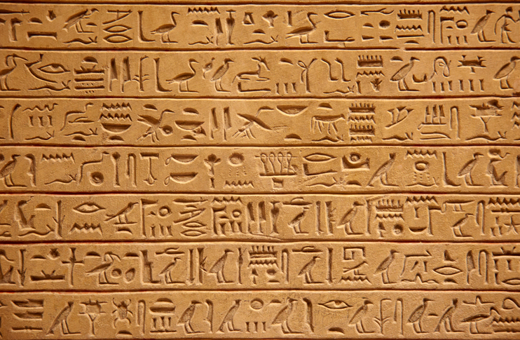
Egyptian Learning Advances
Since hieroglyphs, seen here, took a lot of time and care to write, Egyptian scribes also developed the cursive scripts for quicker use.

Slide 23
Egyptian Learning Advances
Analyze Information In 332 B.C., the Greek ruler Alexander the Great conquered Egypt. According to the information on the chart, how was Egyptian knowledge passed along to other cultures?

Slide 24
Quiz: Religion Shapes Ancient Egyptian Life
How did mummification reflect Egyptian beliefs about the afterlife?
A. Egyptians believed that people did not really die.
B. Egyptians believed in an afterlife in which people would need their bodies.
C. Egyptians believed that only people who were mummies would live forever.
D. Egyptians believed that mummification prevented death.

Slide 25
Quiz: Egyptian Learning Advances
Which of the following identifies important advances in learning made by the ancient Egyptians?
A. Hieroglyphics, knowledge of the human body, and geometry
B. Cuneiform, advanced farming techniques, and pyramids
C. Knowledge of surgery, creation of a legal code, and a writing system
D. Hieroglyphics, surgery, and Hammurabi’s Code

