Slide 1
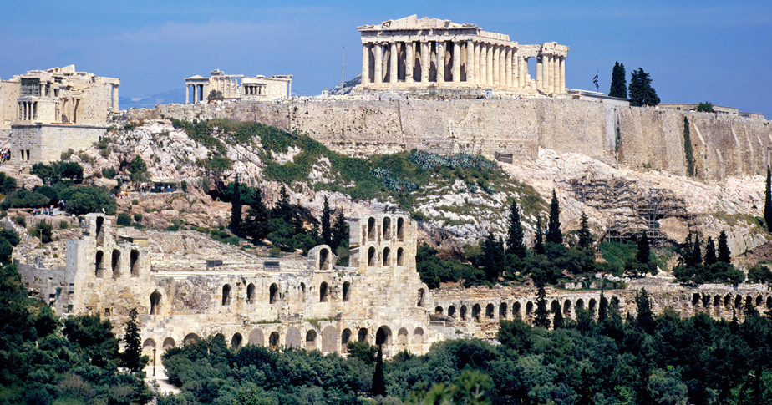
Ancient Greece (1750 B.C.-133 B.C.)
Lesson 2 The Greek City-States

Slide 2
Ancient Greece (1750 B.C.-133 B.C.)
Lesson 2 The Greek City-States
Learning Objectives
Understand how geography influenced the Greek city-states.
Explain how democracy and other forms of government developed in Ancient Greece.
Describe the influence of Ancient Greek concepts related to the rights and responsibilities of citizenship.
Identify the culture and values shared by Ancient Greeks.
Summarize how the Persian and Peloponnesian Wars affected Greece.

Slide 3
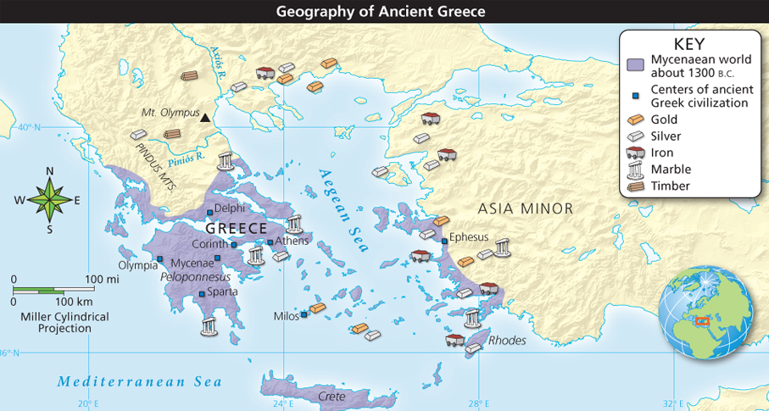
Geography Shapes Greek City-States
Analyze Maps Ancient Greek civilization was shaped by rugged mountainous terrain and surrounding seas. How did the geography of Greece present obstacles to unity? How did the geography of Greece differ from that of other ancient civilizations?

Slide 4
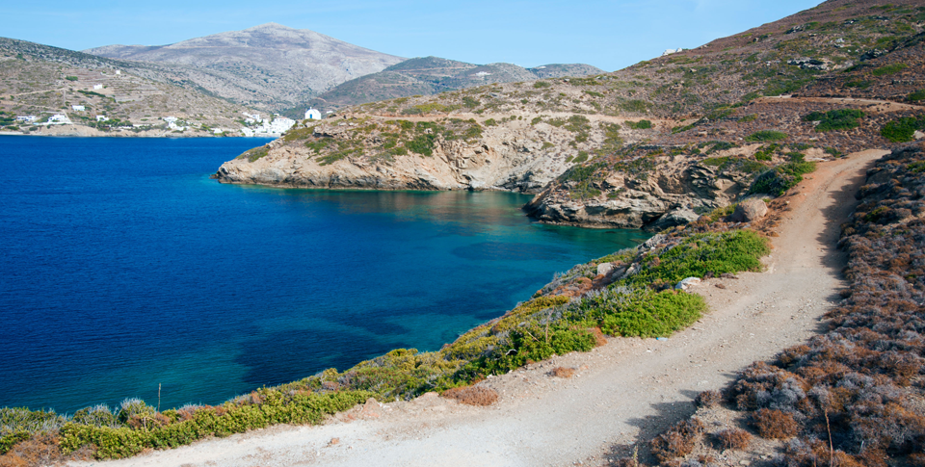
Geography Shapes Greek City-States
Living beside seacoasts or on islands, such as Amorgos, shown here, made the sea familiar to Greeks and encouraged trading ventures.

Slide 5
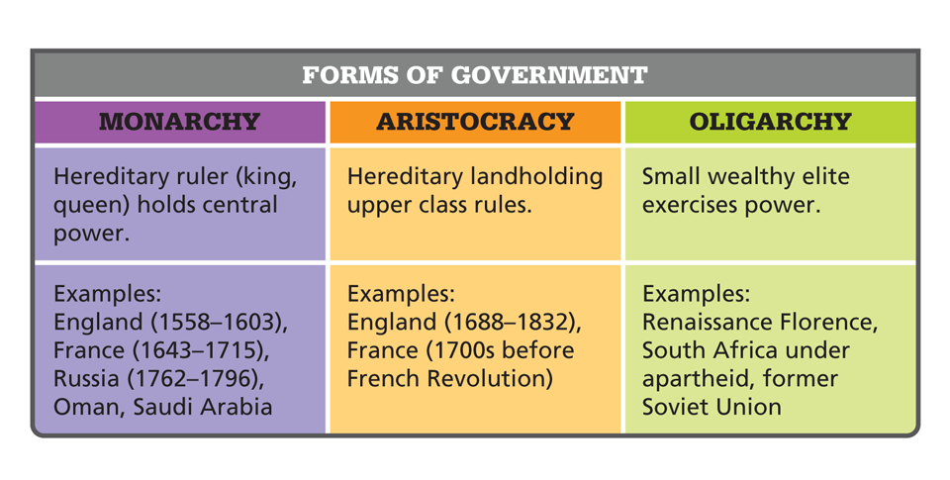
Geography Shapes Greek City-States
Different city-states developed different forms of government. Analyze Charts Athenian democracy evolved from these basic forms of government, which have been used over time in many other places. Describe how an aristocracy and an oligarchy are similar and different.

Slide 6
Separate or United?
Early Greece- people live in city-states
A city-state is a strong city and its countryside that works together as a mini country, also called a Polis
Strong local identification, an independent spirit, and economic rivalry led to fighting among the Greek city-states.
Despite these divisions, Greeks shared a common culture. They spoke the same language, honored the same ancient heroes, participated in common festivals, and prayed to the same gods.

Slide 7
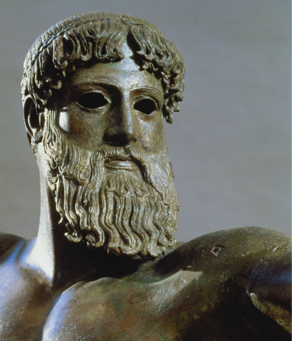
Forces for Unity
This detail of a bronze statue of Zeus or Poseidon from about 450 B.C. demonstrates the strength and energy of Greek religious beliefs.

Slide 8
Greek Religion
Zeus- the most powerful god
The gods on Mt. Olympus

Slide 9
What can we conclude about Athenian culture compared to Spartan culture?
Athenian Art
Spartan Art

Slide 10
Discipline and Warfare in Sparta
Dorian invaders from the north conquered Laconia (Sparta), in the southern part of the Peloponnesus (pel uh puh NEE sus). They settled here and built the city-state of Sparta. The invaders turned the conquered people into state-owned slaves, called helots, and made them work the land. Because the helots greatly outnumbered their rulers, the Spartans set up a brutal system of strict control.

Slide 11
Discipline and Warfare in Sparta
Discipline Rules Daily Life
Spartan Women
Sparta Stands Alone

Slide 12
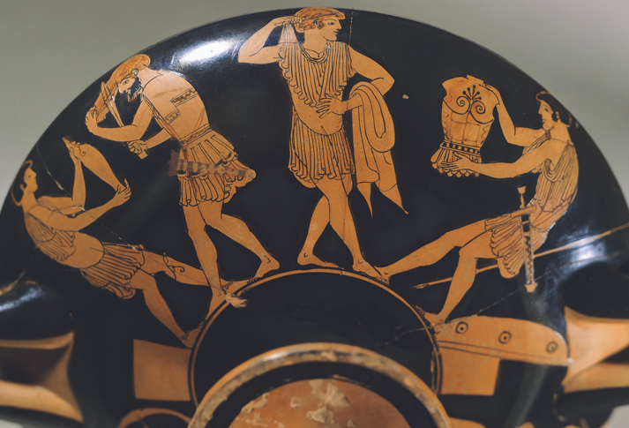
Discipline and Warfare in Sparta
This cup shows Greek warriors putting on their armor. Makron, a well-known artist in Athens, may have painted it around 490 B.C.

Slide 13
Democracy Evolves in Athens
Athens was located in Attica, just north of the Peloponnesus. As in many Greek city-states, Athenian government evolved from a monarchy into an aristocracy. By 700 B.C. landowners held power. They chose the chief officials, judged major court cases, and dominated the assembly.

Slide 14
Democracy Evolves in Athens
Discontent Drives Change
Solon Makes Reforms
Citizens Share Power and Wealth
Democracy Within Limits
Athenian Women
Educating the Young

Slide 15
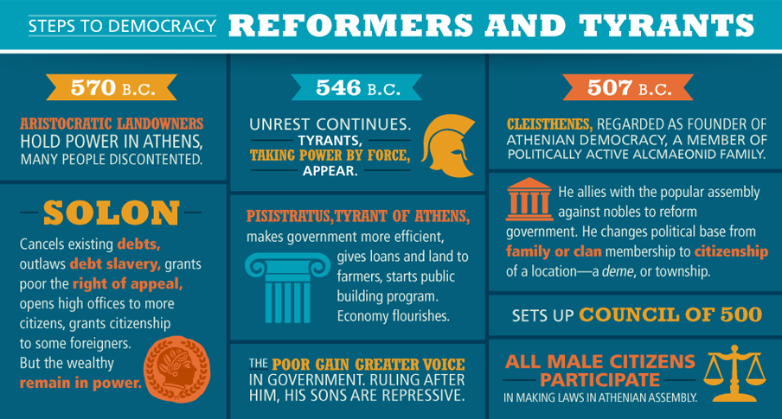
Democracy Evolves in Athens
Motivated by widespread discontent with the aristocracy ruling Athens, political reforms by Solon, Pisistratus, and Cleisthenes were steps in Athenian democracy’s evolution.

Slide 16
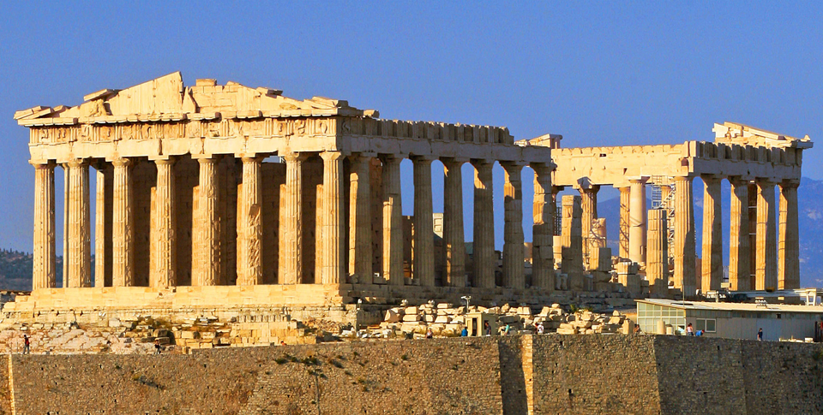
Democracy Evolves in Athens
The Parthenon holds center stage on the ancient Athenian Acropolis. Originally a temple honoring the city’s patron goddess, Athena, the Parthenon is one of the world’s most famous and influential buildings.

Slide 17
Greek Wars with Persia
The Greek city-states were often at odds with one another. Yet when the Persians threatened them, the Greeks briefly put aside their differences to defend their freedom.

Slide 18
Greek Wars with Persia
Athens Wins at Marathon, Salamis, and Thermopylae
Greek City-States Join Together
Athens Leads the Delian League
-Athens is part of this trade group- POWER
- Athens makes big $ trading
- Athens builds a powerful navy
- Pericles uses $ from trade to glorify Athens through statues, buildings, art, culture
- Parthenon is built to worship Athena, goddess of wisdom

Slide 19
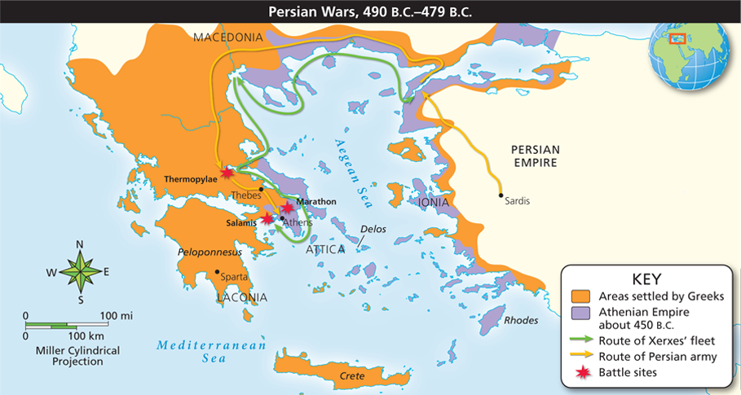
Greek Wars with Persia
Analyze Maps When the Persian empire attacked Greece, the Greek city-states briefly joined forces for defense. Describe the routes of the Persian army and navy toward Athens.

Slide 20
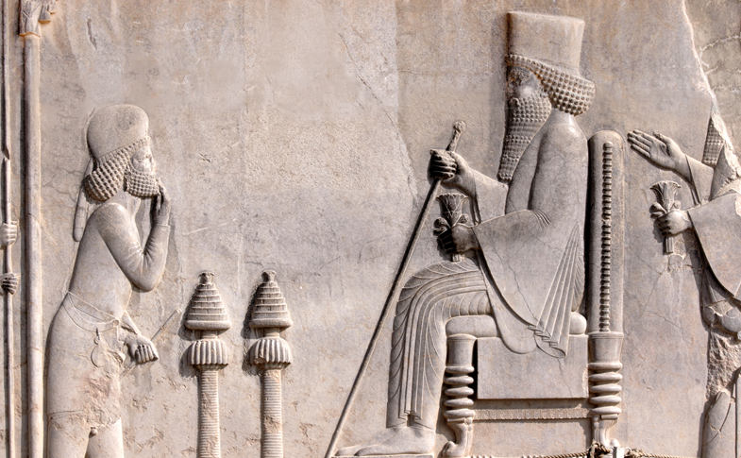
Greek Wars with Persia
The Persian king Darius I is portrayed receiving tribute on this wall relief at the great palace in Persepolis, in present-day Iran.

Slide 21
Pericles, Democracy, and War
The years after the Persian Wars from 460 B.C. to 429 B.C. were a golden age for Athens under the able statesman Pericles (PEHR uh kleez). Because of his wise and skillful leadership the economy thrived and the government became more democratic.

Slide 22
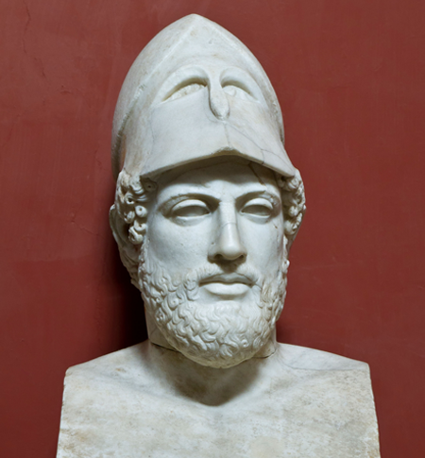
Pericles, Democracy, and War
Pericles (c. 495 B.C.–429 B.C.), shown here in a Roman marble bust copied from a Greek original, came from a rich noble family. His father led the Athenian assembly and fought at Salamis.

Slide 23
Pericles, Democracy, and War
Democracy in Athens
Athenian Culture Thrives
The Peloponnesian War
Athens Defeated by Sparta
The Decline of Greek Dominion

Slide 24
Peloponnesian War Breaks Out
 | Athens | Sparta
Government | Democracy with a law code | Oligarchy with Leadership by a few military leaders
Education | Wealthy boys- grammar, poetry, history, math, athletics | Military education- physical agility and strength major emphasis
Culture | Arts, theater, music, architecture, sculpture | Military service age 7-60, simplicity and stoicism
Women | Taught at home how to raise children, cook, and clean | Encouraged to train militarily, had much more freedom and power in society
Military | Strong Navy | Strong Army

