Slide 1
Origins of Civilization (Prehistory-300 B.C.)
Lesson 1 Learning About Our Past

Slide 2
Origins of Civilization (Prehistory-300 B.C.)
Lesson 1 Learning About Our Past
Key Terms
prehistory.
Historians
artifacts,
anthropology.
culture
Archaeology
Technology

Slide 3
Studying Prehistory
By about 5,000 years ago, groups of people in different parts of the world had begun to keep written records. The invention and use of writing marked the beginning of recorded history. However, humans and their ancestors had lived on Earth for thousands upon thousands of years before the recording of history began. We call the long period of time before people invented writing prehistory.

Slide 4
Studying Prehistory
Studying ancient footprints is one way scientists can learn about the past. These footprints, preserved in volcanic ash, were made in Tanzania some 3.5 million years ago.

Slide 5
Discoveries in Africa and Beyond
Before the 1950s, anthropologists knew little about early humans and their ancestors. Prehistoric groups did not have cities, countries, organized central governments, or complex inventions, so clues about them were hard to find. However, archaeologists in East Africa started uncovering ancient footprints, bones, and tools. With these first key discoveries, scholars began to form a picture of life during prehistory.

Slide 6
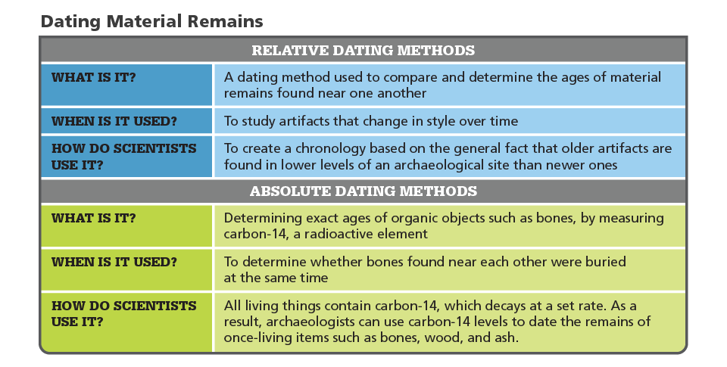
Investigating Prehistory
Analyze Charts Which dating method would you use to determine the age of a fossilized tooth fragment?

Slide 7
Investigating Prehistory
An archaeologist looks for clues in a Maya royal tomb.

Slide 8
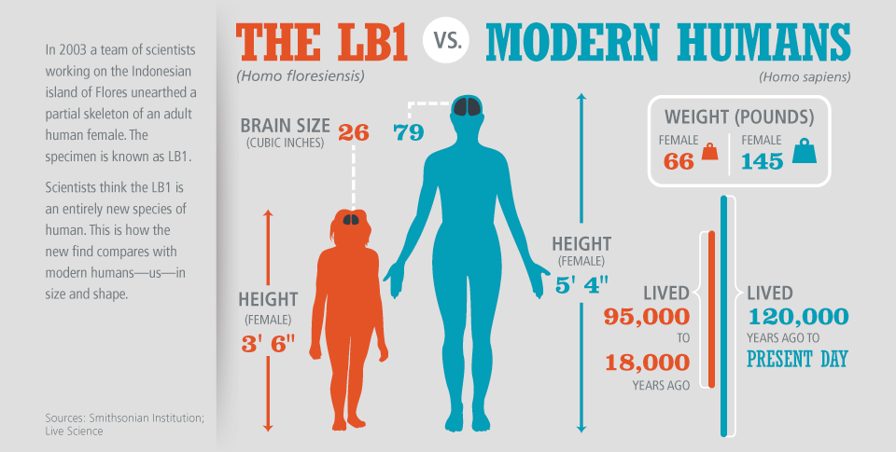
Investigating Prehistory
Apply Concepts How would scientists know whether bones they found in 2003 were those of a new species of hominids?

Slide 9
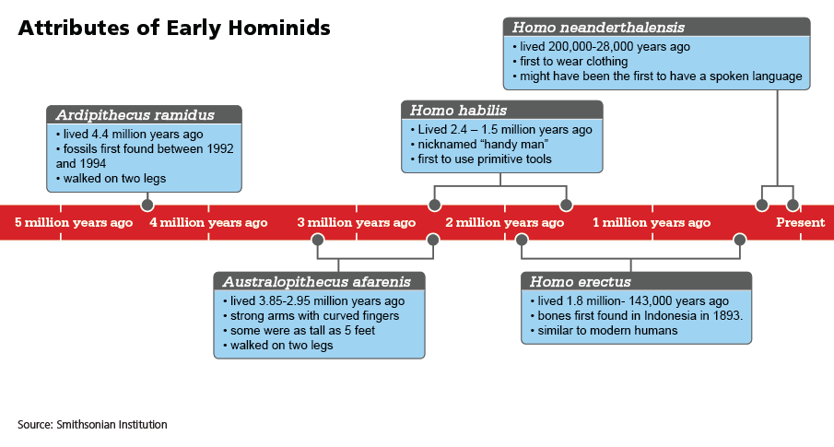
Discoveries in Africa and Beyond
As the centuries passed, hominid groups developed physically and gained new skills.

Slide 10
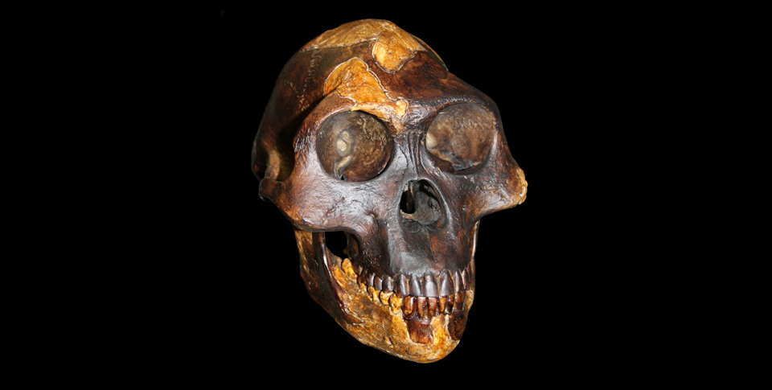
Discoveries in Africa and Beyond
“Lucy” was discovered in Ethiopia in 1974. Scientists date the skeleton to at least 3 million years ago. It was the first time archaeologists had enough of one skeleton to reconstruct and view an actual hominid.

Slide 11
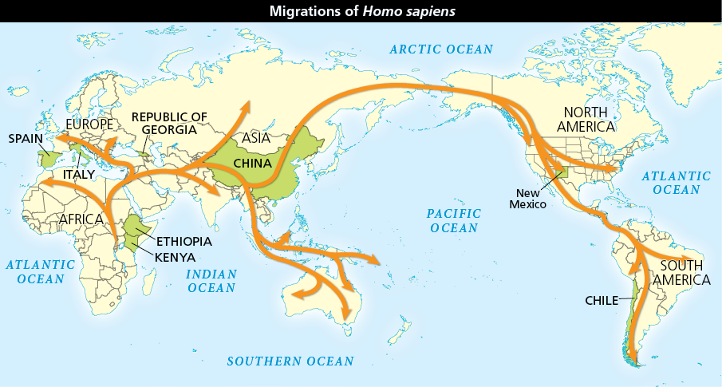
Discoveries in Africa and Beyond
Analyze Maps Homo sapiens migrated along the routes shown on the map. Why would early Homo sapiens follow large herds of animals?

